Slide 1

UNSTEADY MHD POISEUILLE FLOW THROUGH A POROUS CHANNEL UNDER AN OSCILLATING PRESSURE GRADIENT AND UNIFORM SUCTION/INJECTION
Judith N. Balkissoon^{1*}, Sreedhara Rao Gunakala² and
Victor M. Job³
^{1,2,3}Faculty of Science and Technology, The University of the West Indies, Trinidad
¹Email: judith.balkissoon@my.uwi.edu *(Corresponding author)
²Email: Sreedhara.Rao@sta.uwi.edu
³Email: victor.job@sta.uwi.edu

Slide 2

INTRODUCTION
Hydromagnetics/Magnetohydrodynamics
Poiseuille Flow
Brinkman’s Equation

Slide 3
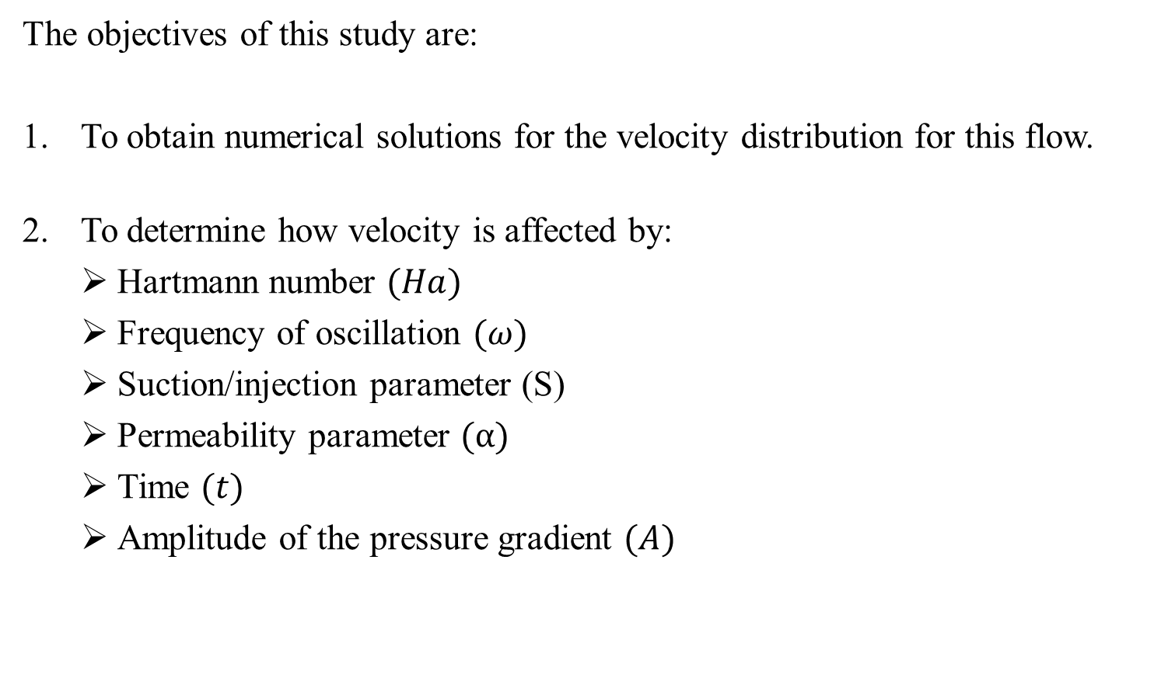
OBJECTIVES
The objectives of this study are:
To obtain numerical solutions for the velocity distribution for this flow.
To determine how velocity is affected by:
  Hartmann number $(Ha)$
  Frequency of oscillation $(ω)$
  Suction/injection parameter (S)
  Permeability parameter $(α)$
  Time $(t)$
  Amplitude of the pressure gradient $(A)$

Slide 4
METHODOLOGY
The Galerkin Finite Element Method was used to solve the governing equation numerically under the initial and boundary conditions.
The weighted integral method was used for the spatial semi-discretization.
The Crank-Nicolson scheme was used for the time discretization.
The elements were assembled and the computer software MATLAB was used to solve the system of equations.

Slide 5
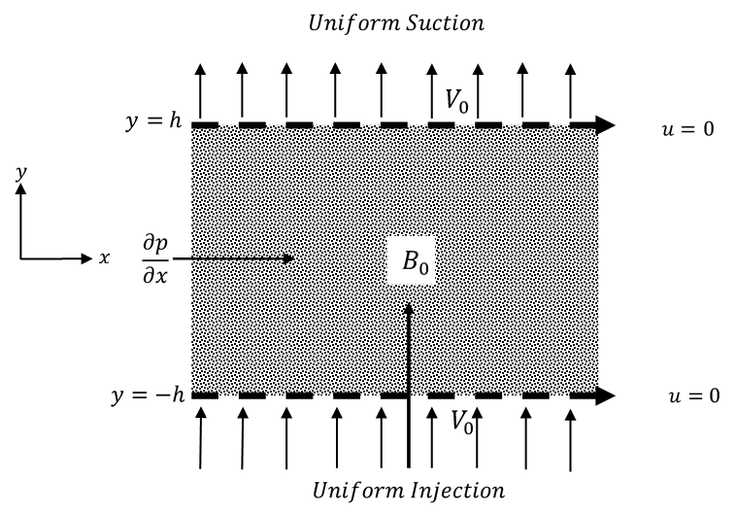
DESCRIPTION OF PROBLEM
Figure 1

Slide 6

GOVERNING EQUATION
Brinkman’s Equation:
$ρ\left(\frac{∂u}{∂t}+V_{0}\frac{∂u}{∂y}\right)=−\frac{∂P}{∂x}+μ\frac{∂^{2}u}{∂y^{2}}−σB_{0}^{2}u−\frac{μ}{K}u$ (1)
Initial and Boundary Conditions are:
  $u=0 \text{at} t=0$
  $u=0 \text{at} y=±h \text{for} t>0$ (2)

Slide 7
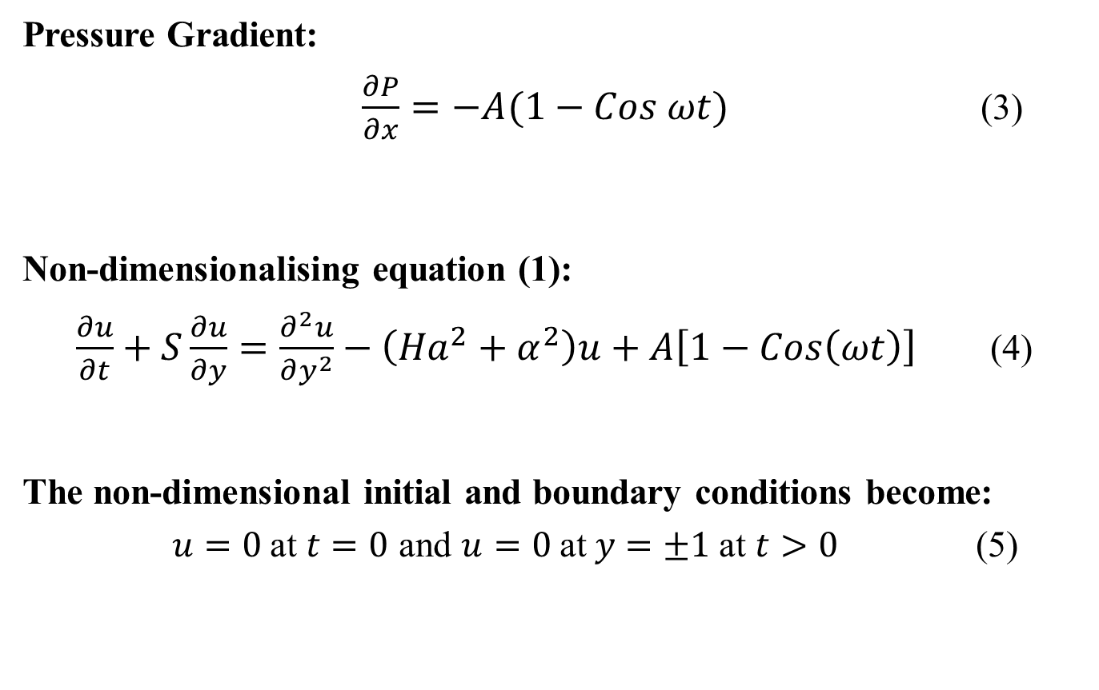
Pressure Gradient:
$\frac{∂P}{∂x}=−A(1−Cos ωt)$ (3)
Non-dimensionalising equation (1):
$\frac{∂u}{∂t}+S\frac{∂u}{∂y}=\frac{∂^{2}u}{∂y^{2}}−\left({Ha}^{2}+α^{2}\right)u+A\left[1−Cos\left(ωt\right)\right]$ (4)
The non-dimensional initial and boundary conditions become:
$u=0 \text{at} t=0$ and $u=0 \text{at} y=±1$ at $t>0$ (5)

Slide 8
RESULTS

Slide 9
RESULTS

Slide 10
RESULTS

Slide 11
RESULTS

Slide 12
RESULTS

Slide 13
RESULTS

Slide 14
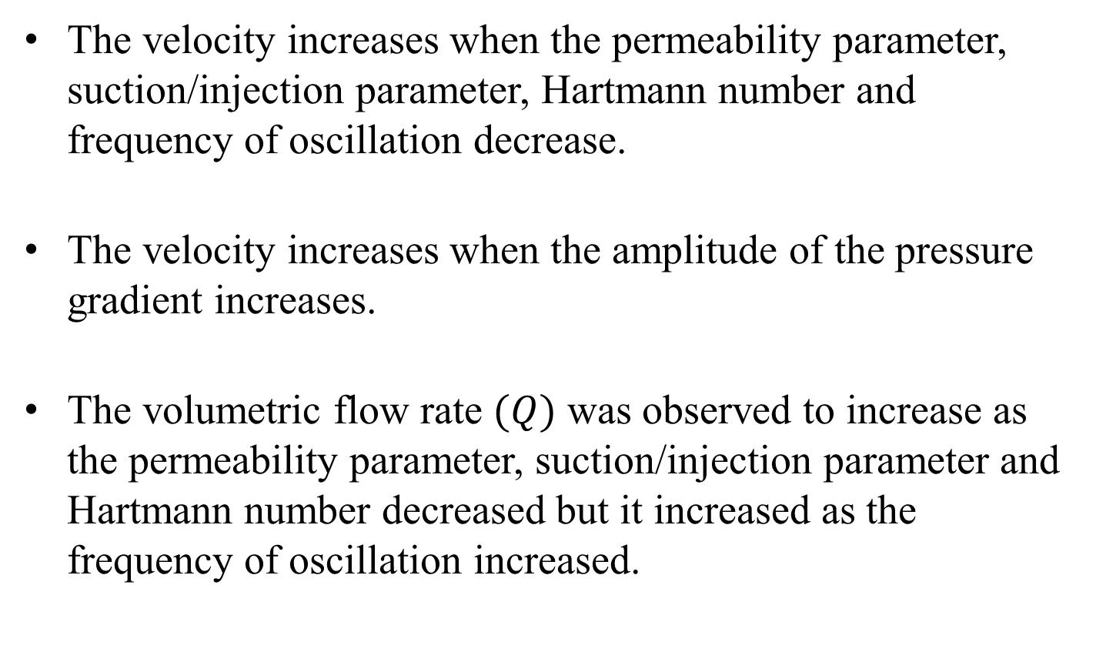
CONCLUSION
The velocity increases when the permeability parameter, suction/injection parameter, Hartmann number and frequency of oscillation decrease.
The velocity increases when the amplitude of the pressure gradient increases.
The volumetric flow rate $(Q)$ was observed to increase as the permeability parameter, suction/injection parameter and Hartmann number decreased but it increased as the frequency of oscillation increased.

Slide 15
REFERENCES
A. A. Moniem and W. S. Hassanin, “Solution of MHD flow past a vertical porous plate through a porous medium under oscillatory suction,” Applied Mathematics, vol. 4, no. 04, pp. 694–694, 2013.
H. A. Attia and M. A. M. Abdeen, “Unsteady Hartmann flow with heat transfer of a viscoelastic fluid under exponential decaying pressure gradient,” Engineering Mechanics, vol. 19, no. 5, pp. 37–44, 2012.
P. A. Davidson, An Introduction to Magnetohydrodynamics. 40 West 20th Street, New York: Cambridge University Press, 2001.
V. G. Gupta and A. Jain, “An analysis of unsteady MHD Couette flow and heat transfer in a rotating horizontal channel with injection/suction,” 2016.M. Parvazinia, V. Nassehi, R. J. Wakeman, and M. H. R. Ghoreishy, “Finite element modelling of flow through a porous medium between two parallel plates using the brinkman equation,” Transport in porous media, vol. 63, no. 1, pp. 71–90, 2006.
V. K. Verma and A. K. Gupta, “Mhd flow in a porous channel with constant suction/injection at the walls,” International Journal of Pure and Applied Mathematics, vol. 118, no. 1, pp. 111–123, 2018.

Slide 16
Questions?
THANK YOU!

