Slide 1
INDUSTRIAL DISCHARGE TOWARD ZERO DISCHARGE (A22) Quamie N. Mortley¹, Winston A. Mellowes^{2E}
Author1 Chemical and Energy Engineering Consultant
Author2 Professor Emeritus
$$⋮$$

Slide 2
INTRODUCTION
Alumina is produced from bauxite ore, using the Bayer process at a Jamaican refinery. The process includes the digestion of bauxite with sodium hydroxide at 135 ºC, hence the requirement for both steam and power. In the course of this extraction, large quantities (>350 m³ /h) of digester condensate are produced. This regenerative condensate is cooled, neutralized and discharged from the site to the environment.
Well water abstraction is restricted by the Water Resource Authority, there is a requirement for minimized liquid discharge of wastewater, and high cost of energy necessitated using the condensate. Removal of Total Organic Carbon (TOC) prevented re-use as boiler feedwater, with an attached US$10 million cost for the removal of TOC.

Slide 3
OBJECTIVES
Given the required capital outlay for treating water and condensate contaminated with organics, a new approach was required. An engineering approach was used.
Thermodynamic modelling of hydrometallurgical processes was used. This area of study include the partitioning of volatile compounds among process liquors, steam and condensates in a train of flash vessels, the development of thermodynamically consistent models for organic impurities in Bayer liquors, and the prediction of their mixing properties with major liquor components.
Determine how much organics is portioning in the condensate.

Slide 4
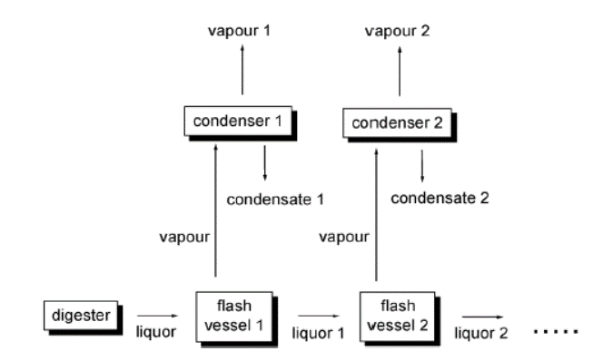
METHODOLOGY
Figure 1-
The liquor enters the first flash vessel from the digester, passes through the subsequent flash vessels operating at successively lower pressures, and is eventually cooled down to boiling temperature at atmospheric pressure.
The methodology used was to collect condensate generated at each flash tank by depressurization and investigate the amount of organics portioning in the condensate.

Slide 5
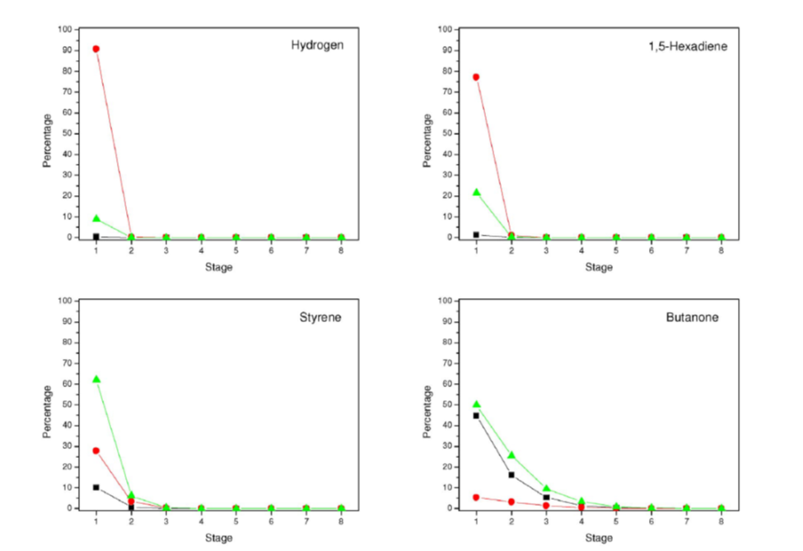
RESULTS
Figure 2 - Relative amounts of selected volatiles in liquor (■), steam (●), and condensate (∆) from analysis of a train of flash vessels in a Bayer plant. The organics in condensate is reduced along the train.

Slide 6
RESULTS
Table 1 – Digester Condensate Chemical Analysis

Slide 7
RESULTS
Condensate fit for use as 600 psig boiler feedwater.
3,066,000 m³/year of wastewater removed from the environment.
Avoided cost for water treatment US$10,000,000.
Fuel Savings US$3,000,000/year.
No capital expenditure.
UWI Engineering in action.

Slide 8
REFERENCES
[1] Konigsberger, E. 2010. Thermodynamics of Impurities in Hydrometallurgical Processes, 14th International Symposium on Solubility Phenomena and Related Equilibrium Processes, Leoben, Austria, (25-30 July 2010).
[2] Clapp, C.E, Hayes, M.H.B. Sizes and Shapes of Humic Substances, Soil Science 164 (1999).
[3] Mullett, M., et al. Removal of Mercury from an Alumina Refinery Aqueous Stream, Journal of Hazardous Materials, 144 (2007).
[4] Personal communication with GE Betz (now Suez Water Management), Trevose, Pennsylvania, United States, who carried out the water analyses.

Slide 9
THANK YOU!

