Slide 1
Analysis of the Cause and Effects of Part Defects in ABS Samples Made Using Additive Manufacturing Arshad Mohammed¹, Boppana V. Chowdary²
^{1,2}Faculty of Engineering, The University of the West Indies, Trinidad

Slide 2
PRESENTATION OUTLINE
Introduction
Methodology
Results and Discussion
Conclusion
Future Research Agenda

Slide 3
INTRODUCTION
Material Extrusion (MatEx) is an Additive Manufacturing (AM) technique of creating parts by depositing material through a nozzle
Top view of layer building process

Slide 4
INTRODUCTION
Raster-raster airgap
Infill rasters
Raster angle
Contour rasters
Road width
Void between contour and raster
Void between contours
Contour-raster interface
Contour-contour interface
Top view and magnified of layer

Slide 5
INTRODUCTION
Advantages of AM over traditional systems:
High product customization possible
Low cost and low lead time for small production runs
Complex and functional
Challenges of AM:
Many process parameters that directly affect the performance of the product
The layer by layer process of AM also results in a reduction of strength of the part

Slide 6
INTRODUCTION
Common trend in literature:
Optimization of mechanical properties of parts made using MatEx
Focus of research:
Investigate the failure of MatEx parts under compression
Investigate the effect of annealing on MatEx parts

Slide 7
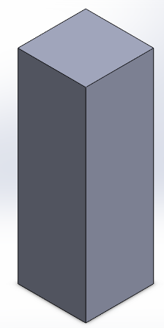
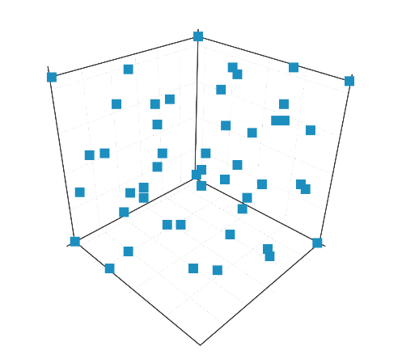
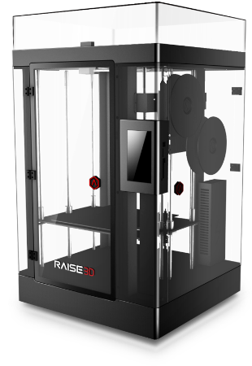
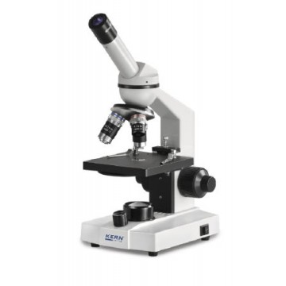
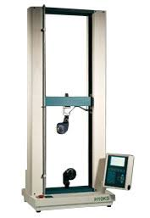
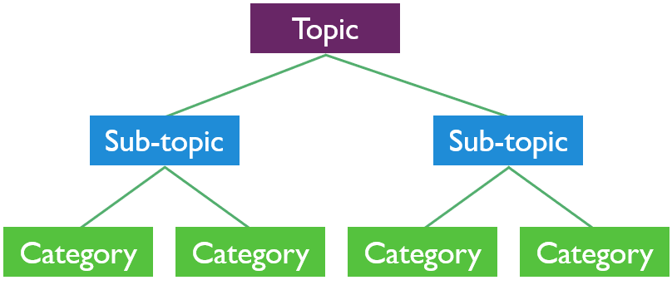
METHODOLOGY
Design Test Specimen
Design Experimental plan
Build Specimens
Classification
Observation of failure
Testing Specimens

Slide 8
METHODOLOGY
An IV-Optimal design of experiments was followed since it allowed for two categorical factors, in this case ‘infill type’ and ‘annealed’. A total of 18 experiments were run
Table 1 summarizing factors and their respective levels
Factor | Levels
 | Level 1 | Level 2 | Level 3
Layer thickness | 0.1 | 0.2 | 0.3
Road width | 0.3 | 0.35 | 0.4
Airgap | 0 | 0.025 | 0.05
Number of contours | 0 | 3 | 6
Build Orientation | 0 | 90 | 180
Infill Type | Lines | Honeycomb | -
Annealed | No | Yes | -

Slide 9
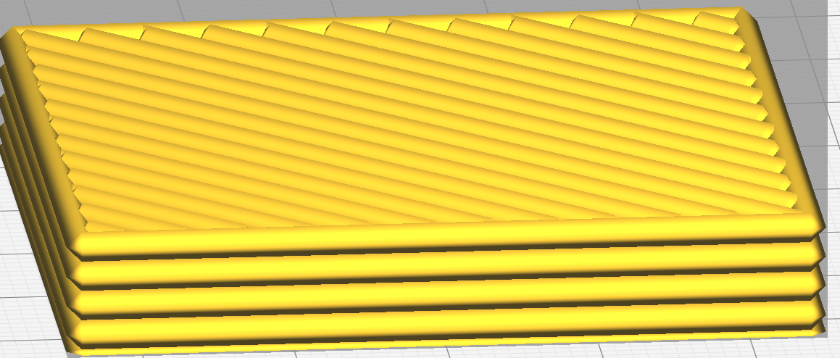
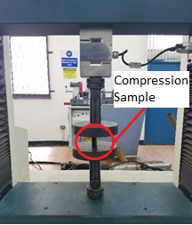
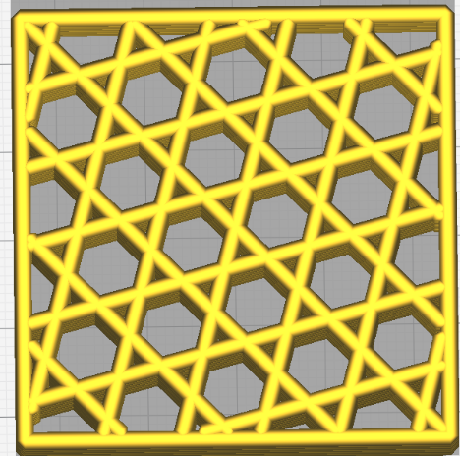
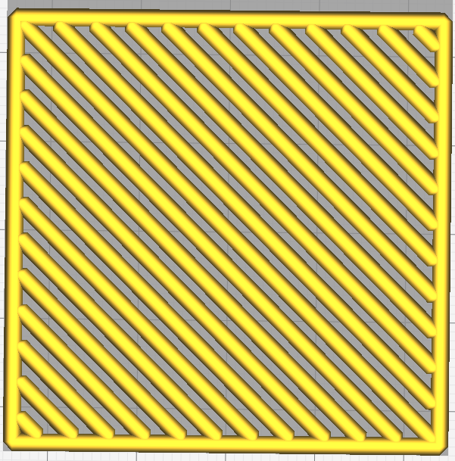
METHODOLOGY
3D view of four layers
Specimen being compressed
Honeycomb infill
Lines infill

Slide 10
Methodology
Samples were made using a Raise3d N2+
Enclosed build chamber to maintain a consistent build environment
Samples were built on the same day to minimize effect of varying external conditions
After building they were stored in individual bags and an air tight container
All samples were tested on the same day, again to minimize external variations

Slide 11
RESULTS AND DISCUSSION
Pareto Chart of process parameters and interactions

Slide 12
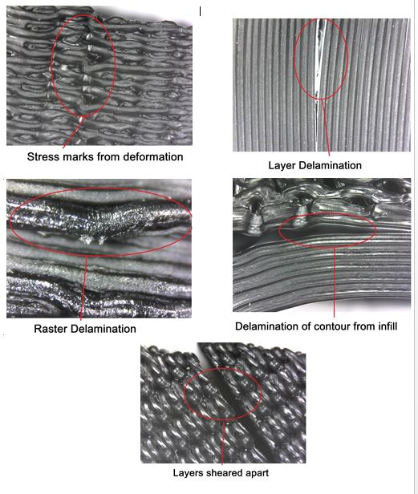
RESULTS AND DISCUSSION
Deformation
Layer Delamination
Raster Delamination
Contour-Infill delamination
Sheared layers
Various defects observed in the failed samples

Slide 13
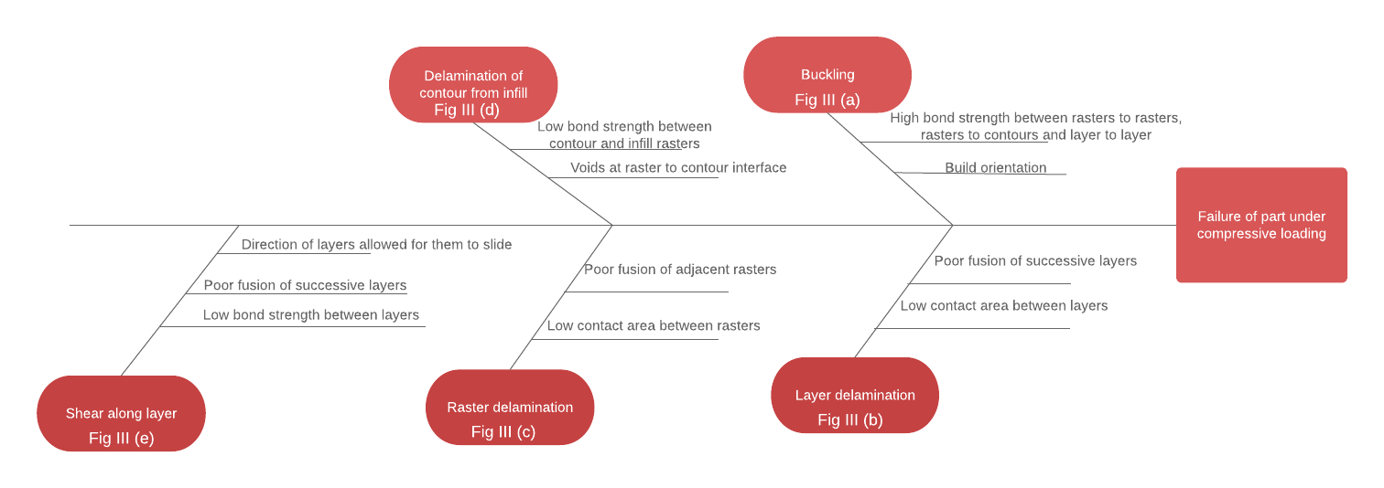
RESULTS AND DISCUSSION
Cause and effect diagram of part failure under compression loading

Slide 14
CONCLUSION
The failure for MatEx parts under compression were categorized into five forms, namely: Layer delamination, buckling, raster delamination, contour-infill delamination, shearing along layer
The most common form of failure observed was layer delamination
The top three influencers for compressive strength were annealing, the interaction of road width and layer thickness followed by layer thickness.

Slide 15
FUTURE RESEARCH AGENDA
Optimization of annealing parameters
Investigation of failure under other loading conditions
Testing of recycled and composite materials
Quantitative analysis on the bond strength of rasters

Slide 16
THANK YOU!

