Slide 1
Description of a Simulated Environment for Validating CFS Autonomy Gerardo Fernandez-Lopez¹, Ruel Ellis², Gerard Pounder³
¹Faculty of Engineering, Simón Bolivar University, Venezuela
^{2&3}Faculty of Engineering, The University of the West Indies, Trinidad

Slide 2
CONTENTS
Introduction
Objectives
Methodology
Literature Review
Design and Implementation of Simulated Environment
Results
References

Slide 3
INTRODUCTION
According to Kattan et al. (2010) problem decomposition:
simplifies complex real world problems to better cope with them;
requires a good understanding of the problem domain.
Kattan et al. (2010) observe that:
“the wrong decomposition may actually increase the problem’s complexity.”

Slide 4
INTRODUCTION
Scientific community decomposed the properties of Intelligence giving rise to:
Symbolic Artificial Intelligence, or AI, Architectures;
Sub-Symbolic, or Reactive, AI Architectures; and
Hybrid AI Architectures (and Behaviour-Based Robots).

Slide 5
INTRODUCTION
Applying the “Questioning Technique” used in Industrial Engineering Work Study we ask:
Is this the only/best way to decompose Intelligence ?
Suppose Intelligence components are not well suited for independent modules in Multi-Agent Systems or MAS ?
Suppose Intelligence components are better served being fit together prior to implementation for it to function effectively, … akin to a car motor ?

Slide 6
INTRODUCTION
(Arkin, 1986; Gat, 1998; Nilsson 2007; Vernon et al., 2007)
GENERAL STRUCTURE OF HYBRID AI ARCHITECTURE
Intentionality
Symbolic / Deliberative Layer
Imagination
Consciousness
Interface / Sequencing Layer
REQUIRED FOR REAL TIME PERFORMANCE
(Leahu et al. 2008)
Sub-Symbolic / Reactive Layer
Emotions
Autonomy

Slide 7
INTRODUCTION
COGNITIVE
FUNCTION
SYNTHESIS
(Arkin, 1986; Gat, 1998; Nilsson 2007; Vernon et al., 2007)
GENERAL STRUCTURE OF HYBRID AI ARCHITECTURE
Intentionality
Symbolic / Deliberative Layer
Intentionality
Imagination
Consciousness
Consciousness
Consciousness
Imagination
Consciousness
Interface / Sequencing Layer
Emotions
Autonomy
REQUIRED FOR REAL TIME PERFORMANCE
(Leahu et al. 2008)
Sub-Symbolic / Reactive Layer
Emotions
Autonomy
Autonomy
Notes:
Observation cognitive functions treated like additional modules of a MAS

Slide 8
INTRODUCTION
Anticipation
MEMORY SEQUENCES
ANTI-CIPATE IMAGE
ANTI-CIPATE STATE
MEMORY SEQUENCES
ANTI-CIPATE ACTION
MEMORY SEQUENCES
Memory
RECALL PRESENT IMAGE
RECALL PRESENT STATE
RECALL PRESENT ACTION
Autonomous Extraction
SEPARATED IMAGE
EXTRACTION
EXTRACTION
CHANGES IN STATE
EXTRACTION
MOTOR COMMANDS
SENSOR DATA
INTERNAL
STATES
REFLEXES
Notes:
Observation cognitive functions treated like additional modules of a MAS

Slide 9
INTRODUCTION
CFS Perceptual Learning, Consciousness and Imagination was demonstrated in recent publication (Pounder et al., 2017);
CFS Autonomy and Emotion still need to be validated.

Slide 10
INTRODUCTION
TO VALIDATE CFS AUTONOMY:
A suitable environment for analysing CFS navigation autonomy, and observe its emergent behaviour needs to be developed;
The environment should comprise a robot platform that is able to operate autonomously when preconfigured with only basic reflexes;
The environment would then need to be validated;
Results from other algorithms need to be identified for use as CFS benchmark metrics;
Only then can CFS performance be validated;

Slide 11
INTRODUCTION
This presentation describes the environment that was developed for analysing CFS navigation autonomy.

Slide 12
OBJECTIVES
To develop a suitable environment for analysing CFS navigation autonomy, and to observe its emergent behaviour:
The environment should comprise a robot platform that is able to operate autonomously when preconfigured with only basic reflexes;
Navigation algorithms ought to be superimposed over the preconfigured robot to enable performance comparison;
Present results from initial experiments.
Scope limited principally to Autonomous Navigation

Slide 13
METHODOLOGY
Review existing platforms referenced in the literature to identify a suitable robot.
Select an appropriate robot simulator for environment design.
Design and implement the environment.
Present initial results.

Slide 14
LITERATURE REVIEW
Surveys by:
Hilal, Wagdy and Khamis (2007); Mondada, Bonani, Raemy (2009); Ruzzenente, Koo, Nielsen (2012); and Junior, Neto, Hernandez (2013)
identified the following candidate platforms:
Gyebi, Hanheide and Cielniak (2015) and Takacs, Eigner, Kovács (2016),
identified additional robot platforms for use as educational tools for Science, Technology, Engineering and Mathematics support, or STEM.
The Pioneer robot was chosen as the platform for experiments in these simulated environment.

Slide 15
LITERATURE REVIEW
The Microsoft Robotics Developer Studio 4 and the V-REP 3.3.2 (rev 3) simulation packages were considered.
V-REP was chosen and installed on a Lenovo P50 64-bit laptop with an Intel Core i7-6820HQ, and a 2.7 GHz processor with 32GB RAM. Code written in C++ with Microsoft Visual Studio 10 was used to run the simulator.
The robot simulator was configured to resemble, as much as possible, the environment described in experiments conducted with Darwin VII (Krichmar and Snook, 2002).

Slide 16
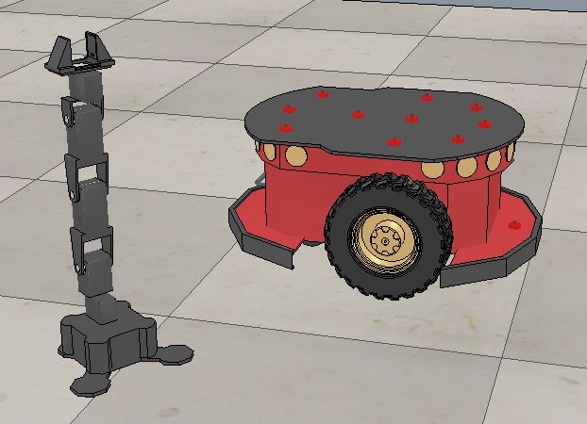
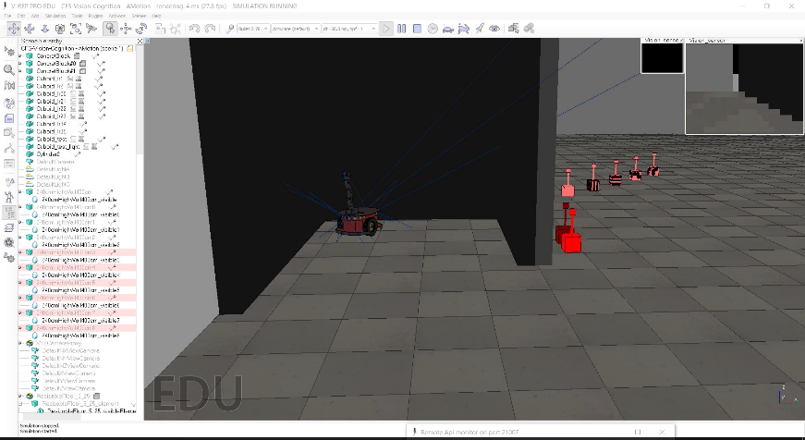
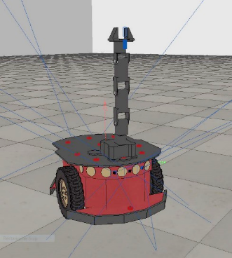
DESIGN AND IMPLEMENTATION OF THE SIMULATED ENVIRONMENT
Vision Sensor and Ultrasound Sensors used in Braitenberg sense to achieve Biomimetic reflexes.
a)
b)
a) PhantomX Pincher manipulator (left) with Pioneer 3DX mobile robot platform (right);
b) PhantomX Pincher fitted to Pioneer 3DX mobile robot platform with vision sensors;
c) Composite Robot Platform In Simulated Environment.

Slide 17
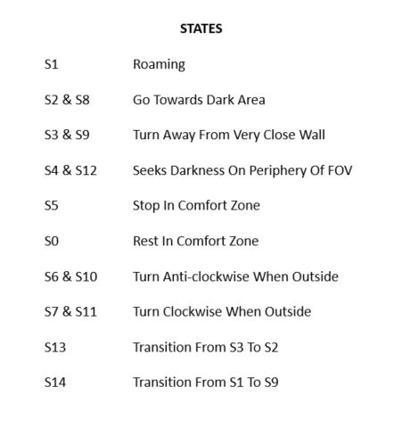
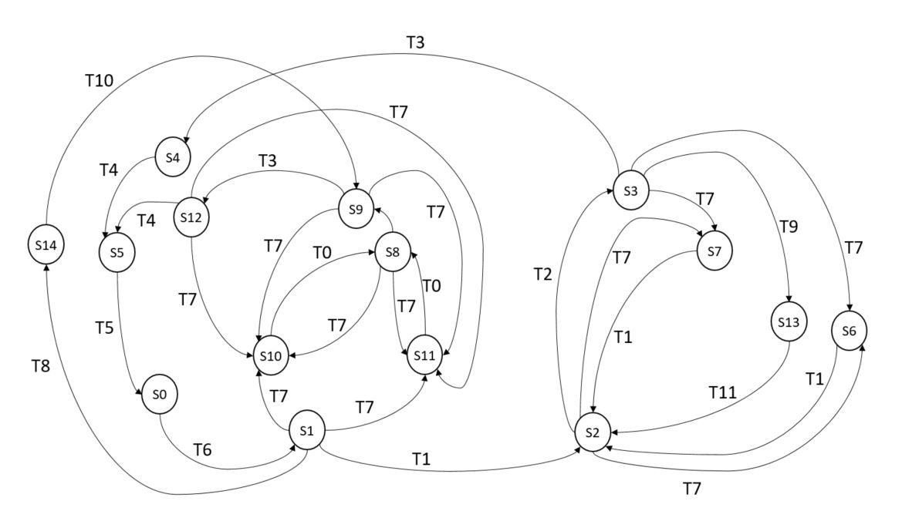
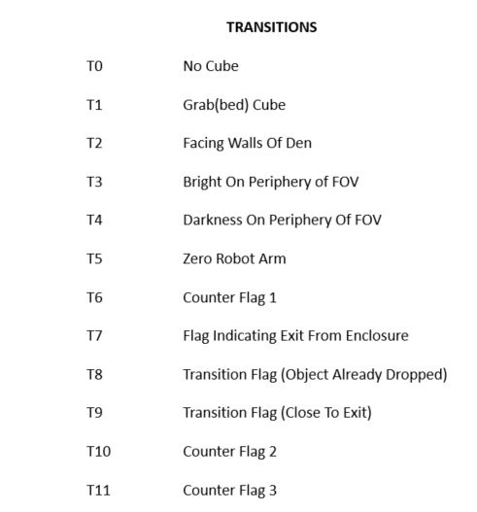
DESIGN AND IMPLEMENTATION OF THE SIMULATED ENVIRONMENT
State Diagram for Robot

Slide 18
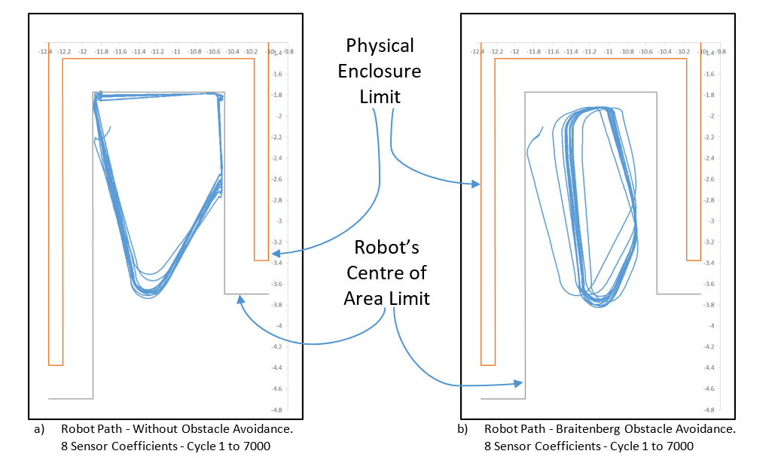
RESULTS

Slide 19
REFERENCES
Kattan, A., A. Agapitos, and R. Poli. 2010. “Unsupervised Problem Decomposition Using Genetic Programming.” In Genetic Programming, edited by A. Esparcia-Alcázar, Springer Berlin Heidelberg.
Arkin, R.C. 1986. “Path Planning for a Vision-Based Autonomous Robot.” In SPIE Conference on Mobile Robots. Cambridge, MA.
Gat, E. 1998. “On three-layer architectures.” In Artificial Intelligence and Mobile Robots: Case Studies of Successful Robot Systems, edited by D. Kortenkamp, R.P. Bonasso, and R. Murphy, Editors. AAAI Press: Menlo Park, California.
Vernon, D., G. Metta, and G. Sandini. 2007. “A Survey Of Artificial Cognitive Systems: Implications For The Autonomous Development Of Mental Capabilities In Computational Agents”. Evolutionary Computation, IEEE Transactions On. IEEE.
Pounder, G.A.J., R.L.A. Ellis, and G. Fernandez-Lopez. 2017. “Cognitive Function Synthesis: Preliminary Results.” Kybernetes 46(2): 272-290.
Hilal, A.R., K.M. Wagdy, and A.M. Khamis. 2007. “A Survey on Commercial Starter Kits for Building Real Robots.” In Proceedings of the International Conference on Electrical Engineering. German University in Cairo, Egypt.
Mondada, F., et al. 2009. “The e-puck, a robot designed for education in engineering.” In Proceedings of the 9th conference on autonomous robot systems and competitions.
Ruzzenente, M., et al. 2012. “A review of robotics kits for tertiary education.” In Proceedings of International Workshop Teaching Robotics Teaching with Robotics: Integrating Robotics in School Curriculum.
Junior, L.A., et al., 2013. “A Low-Cost and Simple Arduino-Based Educational Robotics Kit.” Journal of Selected Areas in Robotics and Control (JSRC) 3(12): 1-7.
Gyebi, E., M. Hanheide, and G. Cielniak. 2015. “Affordable mobile robotic platforms for teaching computer science at African universities.” In Proceedings on the 6th International Conference on Robotics in Education. Cheseaux-Noréaz, Switzerland.
Takacs, A., et al., 2016. “Teacher's Kit: Development, Usability, and Communities of Modular Robotic Kits for Classroom Education.” IEEE Robotics & Automation Magazine 23(2): 30-39.
Krichmar, J.L. and J.A. Snook. 2002. “A neural approach to adaptive behavior and multi-sensor action selection in a mobile device.” In Robotics and Automation, Proceedings. ICRA'02. IEEE International Conference on. IEEE.

Slide 20
THANK YOU!

