Slide 1

A REVIEW OF BIAS IN DECISION-MAKING MODELS
Peter Poon Chong, Terrence R.M. Lalla
Faculty of Engineering,
The University of the West Indies, Trinidad

Slide 2
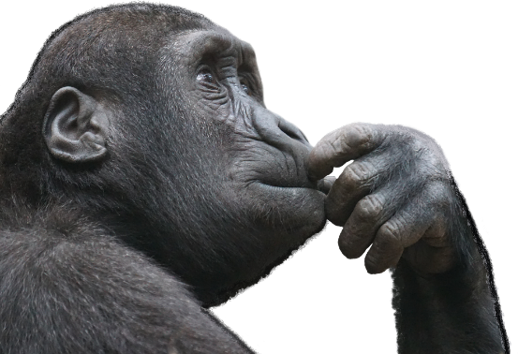




INTRODUCTION
DECISION-MAKING
Rational
  Intuitive
  bias

Slide 3
OBJECTIVES
Appraised the development of the decision-making environment.
Identify the path of bias.
Acknowledge the effect of bias on the variables used in models.
Share some concepts that can assist in the avoidance of bias.
Receive feedback.

Slide 4
METHODOLOGY
This presentation embodies the findings at the early stage of a research to model the manufacture of musical instruments.
Desk study approach.
A collection of qualitative research documents on:
  Decision-Making Models.
  Model variables.
  Bias.

Slide 5


DECISION-MAKING
Decision-making models begin when an actor (an individual or team) desire change of an existing state after discovering a problem.

Slide 6
STEPS IN DECISION-MAKING
Figure General procedure for decision-making

Slide 7
MODELS
Models diligently simulate an environment to determine a most accepted and plausible response.
A model can be considered a mathematical expression closely emulating
  Physical system or process composed of variables or decision parameters.
  Constants and adjustment parameters.
  Input parameters, data.
  Phase/output parameters, noise and random parameters.
Notes:
Dependent Variable reflect the system behavior; Independent Variables are dimensions that determine the system behavior; Parameters reflect the system’s properties or composition and Forcing Functions are the peripheral impacts acting upon the system.
Satisficing is a decision-making strategy that aims for a satisfactory or adequate
Adaptivising Looks for good solutions eg. Moving uphill by contouring

Slide 8
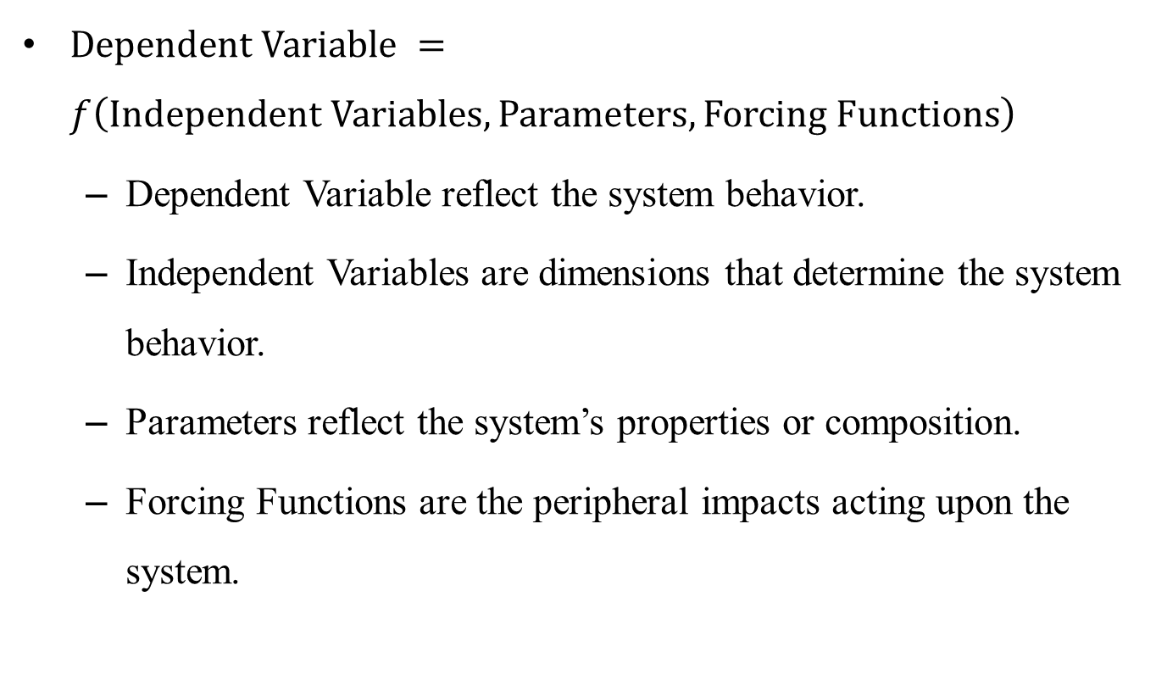
MODELS
$Dependent Variable =f\left(Independent Variables, Parameters, Forcing Functions\right)$
  Dependent Variable reflect the system behavior.
  Independent Variables are dimensions that determine the system behavior.
  Parameters reflect the system’s properties or composition.
  Forcing Functions are the peripheral impacts acting upon the system.
Notes:
Dependent Variable reflect the system behavior; Independent Variables are dimensions that determine the system behavior; Parameters reflect the system’s properties or composition and Forcing Functions are the peripheral impacts acting upon the system.
Satisficing is a decision-making strategy that aims for a satisfactory or adequate
Adaptivising Looks for good solutions eg. Moving uphill by contouring

Slide 9
FEATURE SELECTION
Table Types of variable learning sources
Source | Relation | Data Form
Direct Sensory Experience | Observations from our sensory organs | Responses from sight, smell, taste, touch, and hearing.
Authority | Perceived experiences | From conversation, reading and media.
Electromechanical Sensor | Physical measurements | Data gathering instrumentation.
Reflection | Reorganized thoughts observed | Belief system deduced, induced and reasoned.
Mystic | Human internalizing | Dreams, Subconscious, hallucinations, superstitiously invoked.
Notes:
Dependent Variable reflect the system behavior; Independent Variables are dimensions that determine the system behavior; Parameters reflect the system’s properties or composition and Forcing Functions are the peripheral impacts acting upon the system.
Satisficing is a decision-making strategy that aims for a satisfactory or adequate
Adaptivising Looks for good solutions eg. Moving uphill by contouring

Slide 10
BIAS
Table Foundations of Bias
Category | Source | Cause
Rational decision-making | Experience; Conversion costs and/or uncertainty. | Learning; Comparison to similar situations.
Cognitive misperceptions | Failure; Re-entering experience; Anchoring. | Endowment effect-Snowball effect of negative memories.
Psychological | Misperceived sunk costs; Regret avoidance; Non/optimal Self-perception. | Commitment; Disagreeable experience; Change undesirable.

Slide 11
FINDINGS
Status quo bias
  Product of combined unconscious behaviors performed without retrospective favor.
Stresses of Decision-Making
  Variety of data sources, partial and contradicting.
  Continuously changing environment.
  Management of actors.
  Adverse working environment.
  Failure is not an option.
  Work overload and Time not managed.
  Threatening environment.
Notes:
Dependent Variable reflect the system behavior; Independent Variables are dimensions that determine the system behavior; Parameters reflect the system’s properties or composition and Forcing Functions are the peripheral impacts acting upon the system.
Satisficing is a decision-making strategy that aims for a satisfactory or adequate
Adaptivising Looks for good solutions eg. Moving uphill by contouring

Slide 12
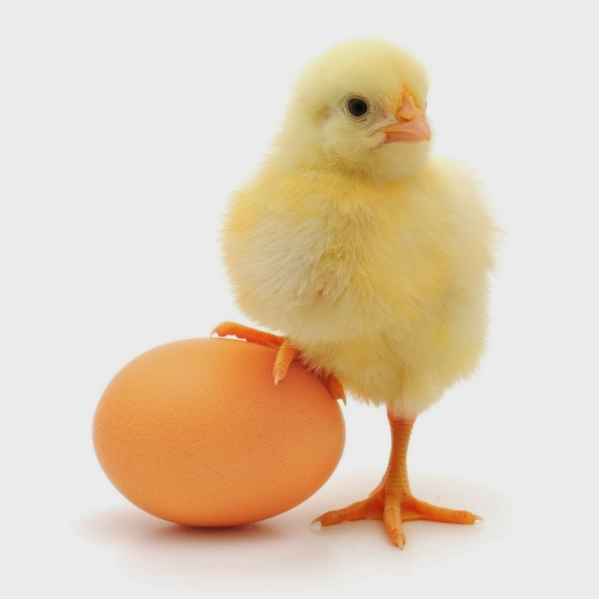
FINDINGS
Care should be taken to provide continuous monitoring of the systems by a manageable ethical team highly competent, cross-functional and willing to learn.
Notes:
Dependent Variable reflect the system behavior; Independent Variables are dimensions that determine the system behavior; Parameters reflect the system’s properties or composition and Forcing Functions are the peripheral impacts acting upon the system.
Satisficing is a decision-making strategy that aims for a satisfactory or adequate
Adaptivising Looks for good solutions eg. Moving uphill by contouring

Slide 13
DISCUSSION
Control of rational and intuitive decision-making environments eases concerns of actors during the process.
According to White, one should apply intelligent systems to automated systems where the environment already exists as venturing into systems with a high degree of understanding.
Unknown systems can be applied experimentally to determine cause and effect situations.
Notes:
Dependent Variable reflect the system behavior; Independent Variables are dimensions that determine the system behavior; Parameters reflect the system’s properties or composition and Forcing Functions are the peripheral impacts acting upon the system.
Satisficing is a decision-making strategy that aims for a satisfactory or adequate
Adaptivising Looks for good solutions eg. Moving uphill by contouring

Slide 14
DISCUSSION
Its risky to run systems automatically with algorithms that initiate and carry out calibrations or changes in its supervised data profiles.
Developing decision-making models should comprise a complex management system operated with persons trained in the discipline of the subject analyzed and psychology.
Notes:
Dependent Variable reflect the system behavior; Independent Variables are dimensions that determine the system behavior; Parameters reflect the system’s properties or composition and Forcing Functions are the peripheral impacts acting upon the system.
Satisficing is a decision-making strategy that aims for a satisfactory or adequate
Adaptivising Looks for good solutions eg. Moving uphill by contouring

Slide 15
VALUE AND PRACTICAL
IMPLICATION
Quality Improves when
  Cognizance of bias.
  Periodically monitor the model with an ethically competent team.
  Under a controlled and assented environment.

Slide 16
CONCLUSION
The components and purpose of models were explored to introduce the selection, influences, and bias on variables.
It was evident that an expected model error will always be present in Decision-Making Models.
The dynamic human cognition combined with the formations from the conscious and unconscious biased circuit within the mind contributes to error.
Evolving intelligent systems require full attention of actors to ensure an ethical result.
Notes:
The paper partially veered to the hard-core components of decision-making which has its own but relative environment and isolated challenges. Many researchers are now focusing on the cause and effects of soft environments, for example, the deliberation on the behavioral cognitive responses of people. In the future, it would be interesting to compare the impact of the management of hard and soft disciplines of decision-making.

Slide 17
FUTURE WORK
Focus on the cause and effects of soft environments
Future Work
  to compare the management of hard and soft disciplines of decision-making.
Notes:
The paper partially veered to the hard-core components of decision-making which has its own but relative environment and isolated challenges. Many researchers are now focusing on the cause and effects of soft environments, for example, the deliberation on the behavioral cognitive responses of people. In the future, it would be interesting to compare the impact of the management of hard and soft disciplines of decision-making.

Slide 18
REFERENCES
J.O. Okoli, G. Weller, J. Watt. Information Processing and Intuitive Decision-making on the Fireground: Towards a Model of Expert Intuition. Cognition Technology & Work 18 no. 1 (2016): 89-103.
M. N. U. Khan, A. N. S. Ernest. 1995. Development of a Mathematical Hydrologic Model of Santa Gertrudis Creek Wetlands in Kingsville, Texas. ProQuest Dissertations and Theses.
J. Kacprzyk, S. Zadro˙zny, M. Fedrizzi, H. Nurmi. On Group Decision Making, Consensus Reaching, Voting, and Voting Paradoxes under Fuzzy Preferences and a Fuzzy Majority: A Survey and a Granulation Perspective. Handbook of Granular Computing (2008) 907-929.
M. H. Bazerman, 2002. Judgment in managerial decision making. Wiley.
K. Burmeister, C. Schade. Are entrepreneurs' decisions more biased? An experimental investigation of the susceptibility to status quo bias. Journal of Business Venturing. 22 no. 3, (2007) 340-362.
P. Marko. Decision Making: Between Rationality and Reality. Interdisciplinary Description of Complex Systems 7 no. 2, (2009) 78-89.

Slide 19
THANK YOU!

