Slide 1

APPLYING FUZZY QFD MCDM TO EVALUATE
MUSICAL INSTRUMENTS
Peter Poon Chong, Terrence R.M. Lalla
Faculty of Engineering,
The University of the West Indies, Trinidad

Slide 2







INTRODUCTION
To improve the quality of musical instruments.
Optimizing the manufacture of musical instruments.
QFD Environment.
Multi-Criteria Decision Making (MCDM) models.

Slide 3

OBJECTIVES
Optimizing the manufacture of musical instruments.
Determine the best features/variables.
Build a model to evaluate the manufacture of musical instruments.

Slide 4
METHODOLOGY
This presentation represents the findings at the early stage of the research to understanding the manufacture of musical instruments.
Desk study approach.
A collection of qualitative research documents on:
  Musical Instruments
    Science.
    Manufacture.
  Decision-Making (#PEOPLE).
  MCDM.

Slide 5
MUSICAL INSTRUMENTS
There are five (5) organological categories
  Idiophones.
  Membranophones.
  Chordophones.
  Aerophones.
  Electrophones.
Notes:
Organological
1. The branch of biology that deals with the structure and function of organs.
2. The branch of musicology that deals with musical instruments and their construction, acoustic properties, classification, history, and broader cultural context.
Idiophones- the sound is formed by the vibrations solely through the instrument’s body
Membranophones- the sound is developed by the vibrations of a tensioned membrane
Chordophones- the sound is established by the vibrations of a tensioned string
Aerophones- the sound is created by constrained vibrating air
Electrophones- the sound is sourced from signals built electronically

Slide 6
PARAMETERS OF A
MUSICAL INSTRUMENT
  Figure Overview of Parameters

Slide 7
ACOUSTIC PERCEPTION RELATION
Table Acoustic dependency levels of the perceived
quality of sound on physical parameters
PHYSICAL PARAMETER | PERCEIVED QUALITY
 | Loudness | Pitch | Timbre | Duration
Pressure | High | Low | Low | Low
Frequency | Low | High | Medium | Low
Spectrum | Low | Low | High | Low
Duration Measured | Low | Low | Low | High
Envelope | Low | Low | Medium | Low

Slide 8
GERSHENSON’S TAXONOMY
Table Requirements for engineering categories
Category | Requirements
End-user | Performance characteristics, usability, aesthetics, and styling
Regulatory | Safety, health, environment, and product retirement
Corporate | Marketing, business environment, strategic management, finance, accounting, and product manufacturing, distribution, support and service, and retirement
Technical | Product manufacturing, material, and parts availability

Slide 9
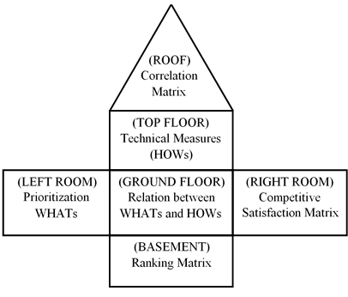
QUALITY FUNCTION DEPLOYMENT
(QFD)
Figure House of Quality (HOQ)

Slide 10
QUALITY COMPONENTS
Table Integrated QFD Inputs
 |  |  | OPERATION PLANNING
 |  | PROCESS PLANNING |  | Operations & Control Quality Delivery Assembly Schedule Inspection
 | PART DEPLOYMENT |  | Manufacturing Operations Knowledge Skill Facility Equipment Material Utility
PRODUCT DESIGN |  | Product Characteristics End-user Regulatory Corporate Technical
Customer Requirements Loudness Pitch Timbre Duration Musicianship Physical Control | Design Requirements Pressure Frequency Spectrum Envelope Expression

Slide 11
MODEL DEVELOPED
Figure Fuzzy QFD TOPSIS AHP Model

Slide 12
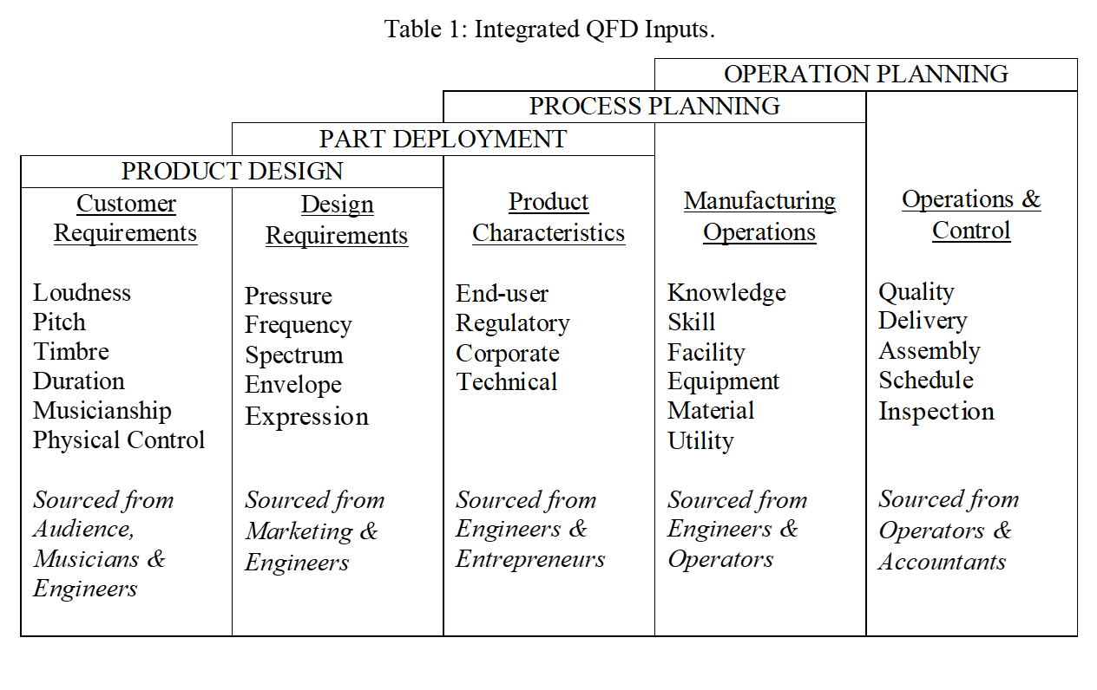

MODEL DEVELOPED
Figure Map of the model

Slide 13
DISCUSSION
Psychological component
  Reduce loss of relevant data.
Physical parameters
  Engineering.
  Perceived qualities.
Assess individual’s
  Affection, cognition, and emotional state.
Notes:
Traditional engineering design has established many methods of making choices for physical components. The psychological component may be less developed potentially losing relevant data hindering the assurance of a satisfied customer.
Capturing the full view of the customer involves a model that ensures the simultaneous compatibility of data derived from tangible and non-tangible features. Tangible features can be assessed with the accepted traditional engineering design principles. The psychological component assesses an individual’s affection, cognition, and emotional state. Table 4 shows the components, highlighting and revealing some key limitations of the symbiotic relationship found in the Fuzzy QFD TOPSIS AHP Model.
The musical relationship of the physical parameters with the perceived qualities was discovered to be high for pressure vs loudness, frequency vs pitch, spectrum vs timbre and duration measured vs duration. This provides a datum to monitor the Product Design component in the QFD to ensure the solution is reliable. Finding a pressure ranking that is higher with the pitch over loudness is inconsistent. The assessment may be unreliable and should be reviewed to rectify or at least justify this solution.

Slide 14
PRACTICAL IMPLICATION
Table Summary of the Fuzzy QFD TOPSIS AHP Model Components
Purpose of Component | Benefits | Limitations
QFD Identify and prioritize the solution HOWs translated from customer WHATs . | Processes customer views. Improves product performance. | Can be complicated. Takes considerable time.
Fuzzy Provides a compatible path to process the quantitative and qualitative data. | Allows subjectively vague data. Simultaneously retrieve data from different levels of groups. | Adds more complex calculations.

Slide 15
PRACTICAL IMPLICATION
Table Summary of the Fuzzy QFD TOPSIS AHP Model Components
Purpose of Component | Benefits | Limitations
TOPSIS Determines and ranks the interrelations between the WHATs and HOWs. | Ranking of real situations. Measure relative distances to positive ideal solution and negative ideal solutions. | Not compatible with crisp values.
AHP Determines and ranks the isolated individual relations on the WHATs and HOWs. | Pairwise comparison. Computation tests the validity of internal ranks. | More complex computations.

Slide 16
CONCLUSION
Structure to identify requirements for musical instruments
Fuzzy QFD TOPSIS AHP Model
  -Qualitative data
  -Measures the relations
  -Ranks both WHATs and HOWs (individually and against)
Incorporate views
  -Musicians -Audience members
  -Manufacturers -Entrepreneurs.
Notes:
The contents of this paper introduce the portion of a study that involves the redevelopment of a musical instrument. It builds on a structure that identifies requirements for a musical instrument, simultaneously incorporating the views of musicians, audience members, manufacturers, and entrepreneurs. The development or modification stage of the instrument requires that the majority of the features, WHATs throughout the four QFD steps should satisfy its stakeholders. A Fuzzy QFD MCDM environment increases the opportunity to identify and provide acceptable decisions throughout the manufacturing life cycle of the product. This Fuzzy QFD TOPSIS AHP Model accepts qualitative data, measures the relations and ranks both WHATs and HOWs individually and against each other. It also captures the non-technical qualities of the musical instrument at different levels and a variety of sources, reducing the uncertainty gap to have an all-inclusive satisfaction level.

Slide 17
FUTURE WORK
A case study will be developed on a common musical instrument to test the model.
Validate the model results
Determine any deficiencies involving bias.
Notes:
In the next stage of this project, a case study will be developed on a common musical instrument to test the model. This should validate the model results and determine any deficiencies involving bias.
The effects of capturing the psychological components in the model are also an important feature to compare with a traditional QFD. The similarity between AHP and TOPSIS should also be compared to ensure and correct any discrepancies that would affect the overall results and objectives.

Slide 18
REFERENCES
U. G. Wegst. Bamboo and wood in musical instruments. Annual Review of Materials Research 38 no. 1, (2008) 323–349.
G. Paine. New Musical Instrument Design Considerations. IEEE MultiMedia 20 no. 4, (2013) 76-84.
T. D. Rossing, 2002. The science of sound. Addison Wesley.
K. S. Rounds, J. Cooper. Development of product design requirements using taxonomies of environmental issues. Resarch in Engineering Design 13 no. 2, (2002) 94-108.
G. Z. Jia and M. Bai. An approach for manufacturing strategy development based on fuzzy-QFD.
M. Moayeri, A. Shahvarani, M. H. Behzadi, and F. Hosseinzadeh-Lotfi. Comparison of Fuzzy AHP and Fuzzy TOPSIS Methods for Math Teachers Selection. Indian Journal of Science and Technology 8 no. 13, (2015).
İ. Ertuğrul. Comparison of fuzzy AHP and fuzzy TOPSIS methods for facility location selection. International Journal of Advanced Manufacturing Technology 39 no. 7, (2008) 783-795.

Slide 19
THANK YOU!

