Slide 1

Validation of a Simulated Environment for Validating CFS Autonomy
Ruel Ellis¹, Gerardo Fernandez-Lopez², Gerard Pounder³
^{1&3}Faculty of Engineering, The University of the West Indies, Trinidad
²Faculty of Engineering, Simón Bolivar University, Venezuela

Slide 2
CONTENTS
Introduction
Objectives
Methodology
Literature Review
Design of Experiments: System & Dependent Variables
Results
References

Slide 3
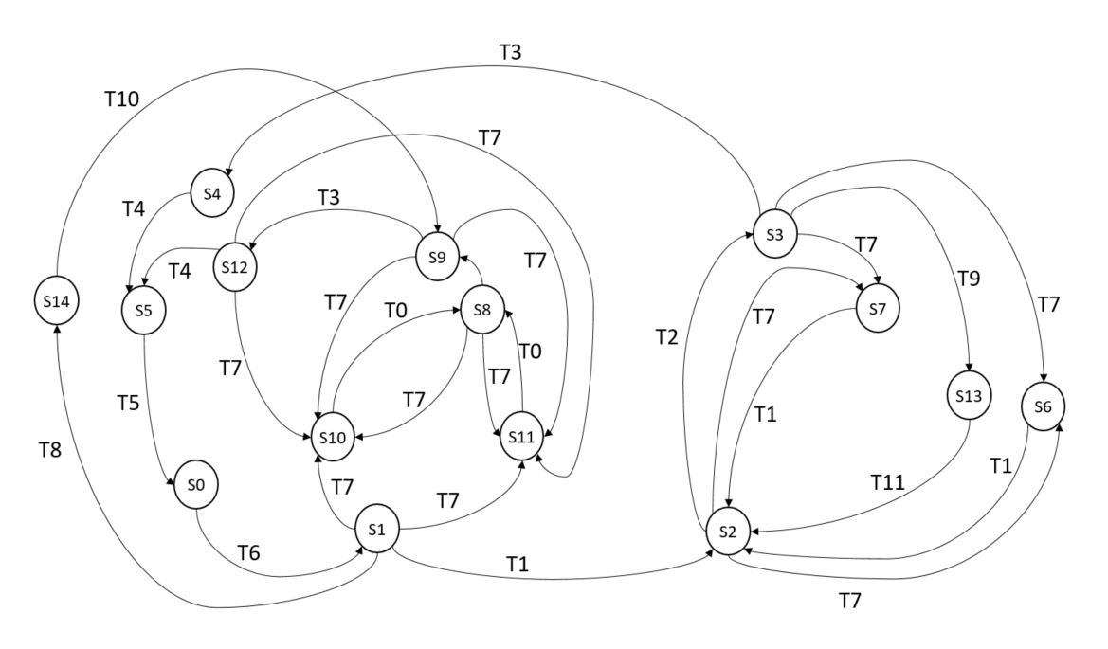
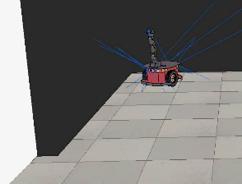
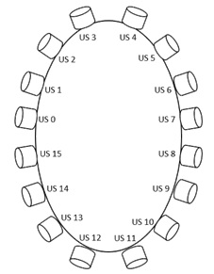
INTRODUCTION
A previous presentation described the environment developed for CFS Navigation Validation.
This presentation showcases the findings obtained from the simulated environment developed for analysing CFS navigation autonomy.
Ultrasound Sensor Configuration
Figure 1. State Diagram for robot, screenshot of environment and US configuration

Slide 4
OBJECTIVES
To identify dependent and independent variables for the simulated environment.
To design experiments to determine whether the difference in system performance with/without an Obstacle Avoidance Algorithm is statistically significant.
To present findings.

Slide 5
METHODOLOGY
Identify the dependent and independent variables.
Design experiments to determine whether the difference in system performance with/without an Obstacle Avoidance Algorithm is statistically significant.
Compare performance and present findings.

Slide 6
LITERATURE REVIEW
Artificial General Intelligence, or AGI, recommends a functional structure of cognitive modules in which interdependent relationships between components are identified ‘a priori’ (Bach 2008).
  Cognitive theories may incorporate cognitive functionality as independently subsisting cognitive modules … where the cognitive modules are treated as ‘add-ons’ (Arkin 1998, Opie 1998, Franklin 2007)
  Other theories may incorporate Agents (Wei and Hindriks 2013).
Bruckner et al. (2012) observed an openness to new conceptual frameworks for cognitive approaches to AI amongst researchers.
Pounder, Ellis and Fernandez-Lopez (2017) introduced the Cognitive Function Synthesis (CFS) conceptual framework to AGI.
Fernandez-Lopez, Ellis and Pounder (IConETech 2020) described the simulated environment developed to investigate CFS navigation.
This paper presents results to validate this simulated environment.
Notes:
Some examples of this are: Emergentist Cognitive Architectures of Biomimetic inspiration that model the brain through the use of ANN-type memory based systems by De Garis et al. (2010) and Goertzel et al. (2010); the Hierarchical Temporal Memory HTM by Hawkins (2013) and Darwin VII on NOMAD by Edleman et al. (2008), which emulate brain structure.
CFS postulates that at the “core” of intelligence in hybrid architectures, “interdependent” cognitive functions are synthesised through the interaction of various associative memory (AM)-based systems. The authors posit that this synthesis could form an interface layer between deliberative/symbolic and reactive/sub-symbolic layers in hybrid cognitive architectures.

Slide 7
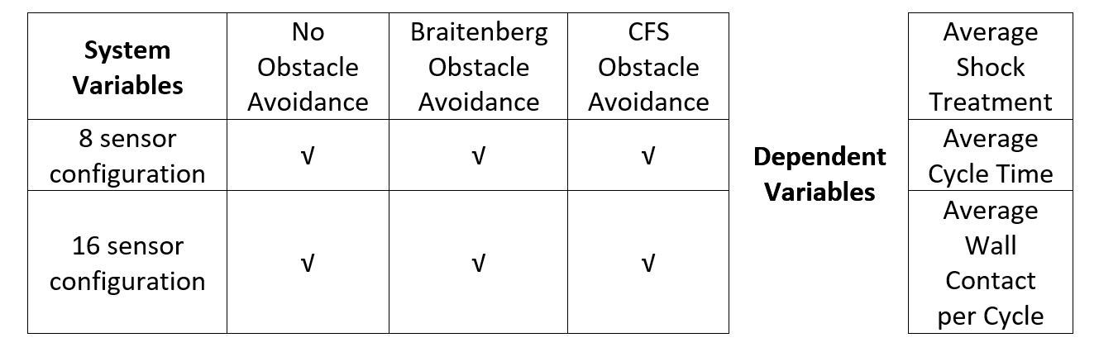

DESIGN OF EXPERIMENTS:
SYSTEM & DEPENDENT VARIABLES
Table 1. System Variables and Dependent Variables For Obstacle Avoidance
7
7
7
7
n = number of experiments required
S = Sample standard deviation
x = mean
A = required accuracy

Slide 8
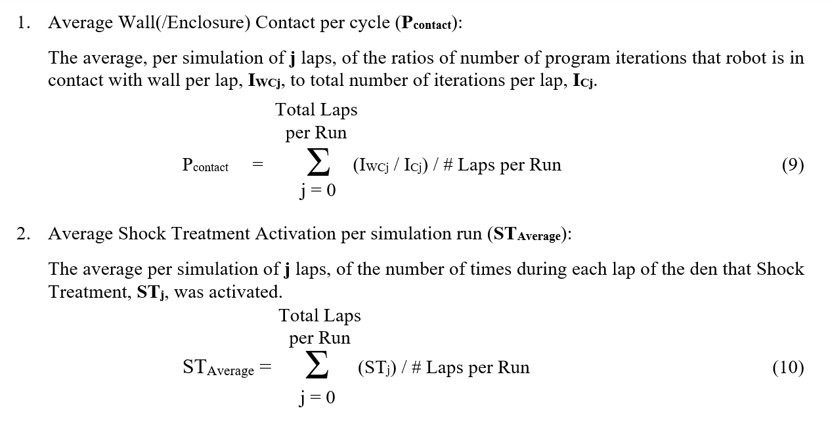
THE DEPENDENT VARIABLES
(1)
(2)

Slide 9
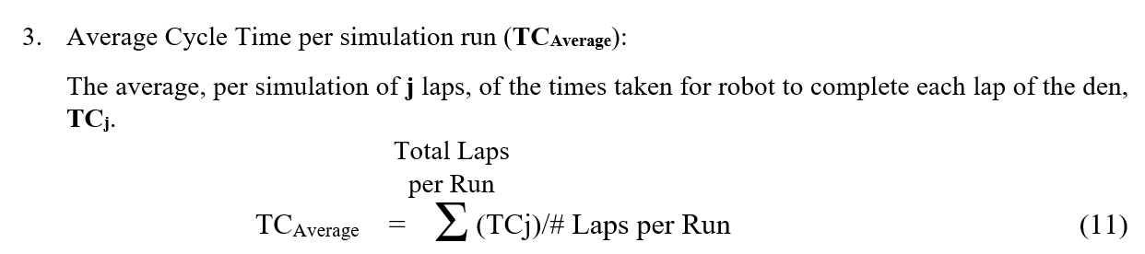
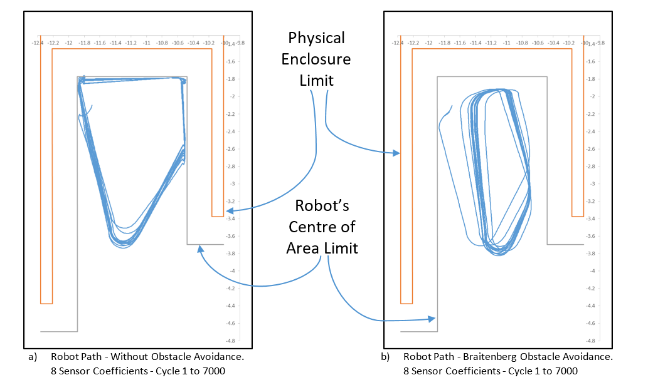
THE DEPENDENT VARIABLES
(3)
Figure 5.
Previously illustrated initial results of robot performance with and without obstacle avoidance

Slide 10
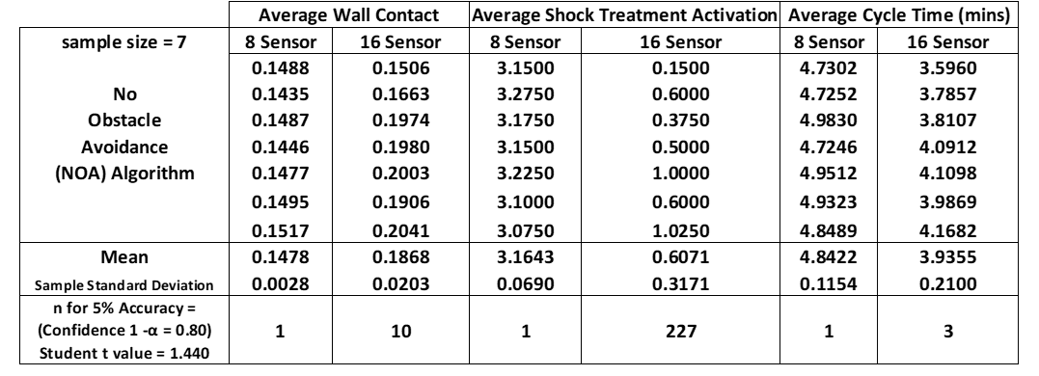
RESULTS
Table 2. Robot Performance Results With Only Basic Reflexes

Slide 11
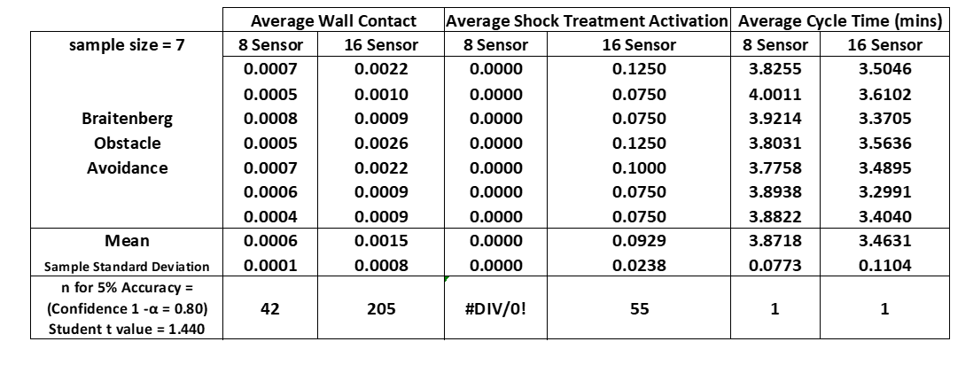
RESULTS
Table 3. Robot Performance Results With Braitenberg Obstacle Avoidance
Notes:
Little variation for Average Cycle Time values: this results in all findings for Cycle Time able to predicate for population.
Similarly, the little variation for the ‘Contact/Collision’ experiment with ‘8 US Sensor’ enables the results for the dependent variables of Average Wall Contact and Average Shock Treatment to be predicated of the population.
The other results cannot speak for the population but are instructive to guide further work.

Slide 12
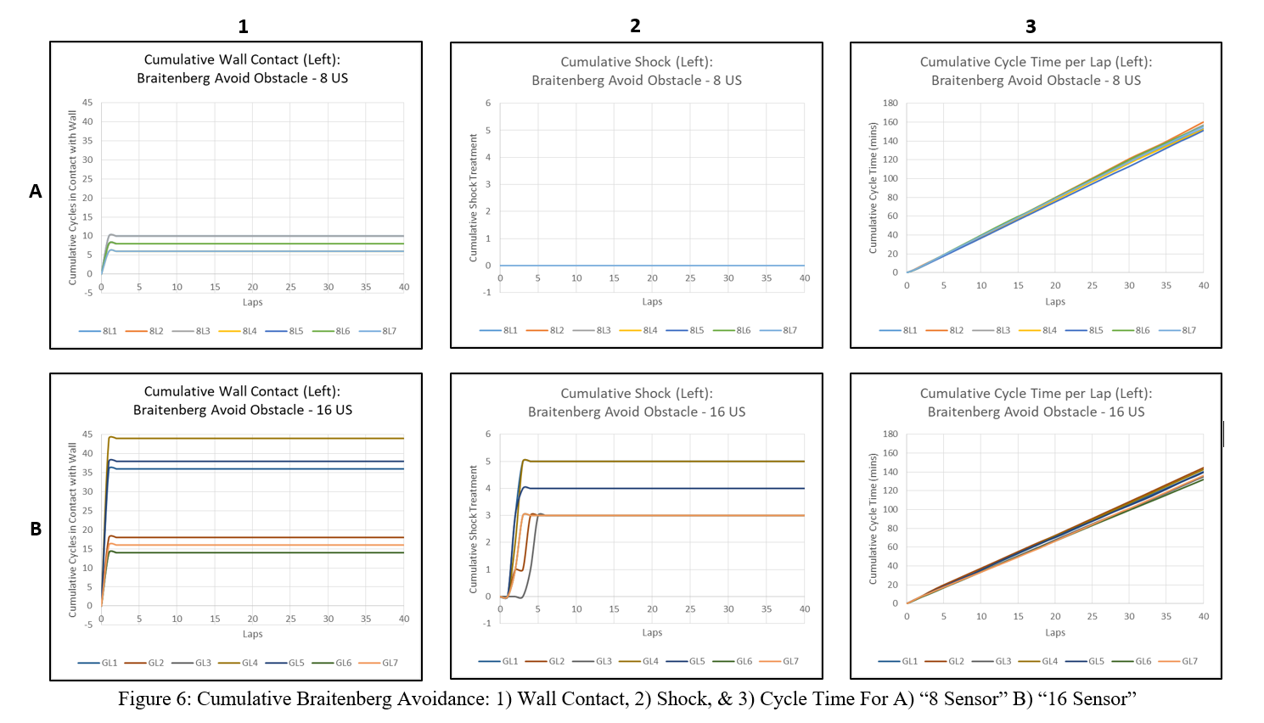
RESULTS

Slide 13
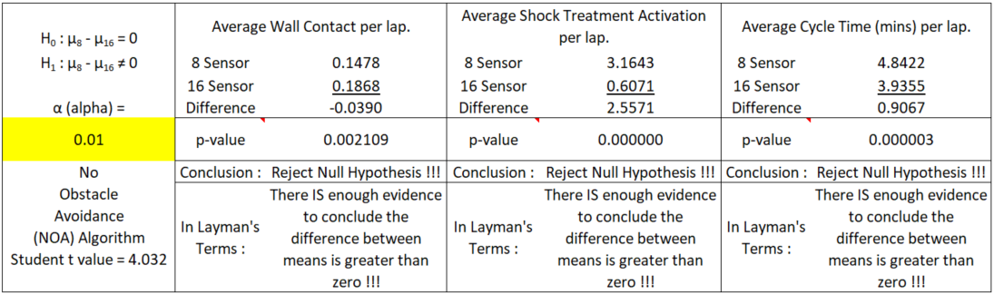
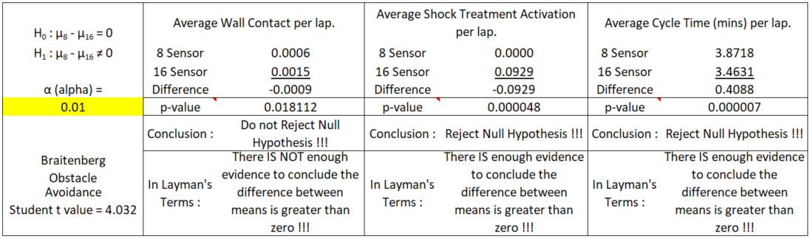
RESULTS
Table 4. Independent Samples Hypothesis Test for a Difference Between Sample Means between 8-sensor and 16-sensor configuration

Slide 14
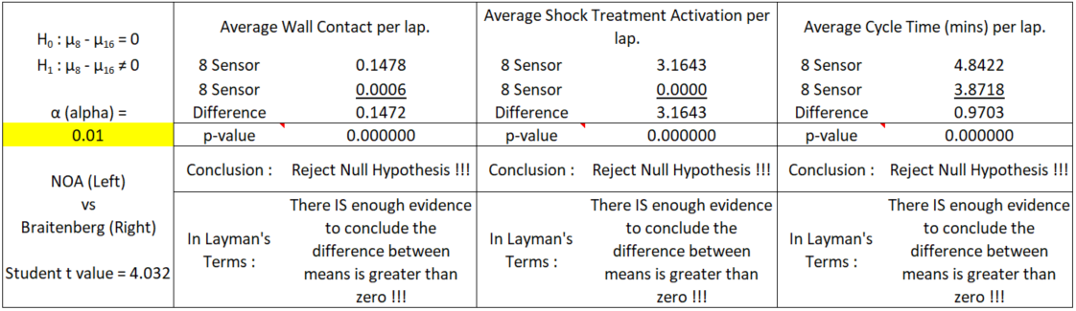

RESULTS
Table 5. Independent Samples Hypothesis Test for a Difference Between Sample Means between Braitenberg and No Obstacle Avoidance
Notes:
For both the ‘16 sensor’ and the ‘8 sensor’ US configuration, the difference in performance between the ‘Contact/Collision’ experiment and the Braitenberg Obstacle Avoidance experiment was significant for all dependant variables.
These results demonstrate that the observed performance differences were not the result of some inexplicable cause but of the Obstacle Avoidance algorithm in one instance and of the number of US sensors on the robot in the other.
These results, therefore, also validate the robot platform and simulated environment, which can thus be used in future obstacle avoidance experiments.
Results also show that, where sensor configuration is held constant, the improved performance of the Braitenberg algorithm on all metrics was significant.
As such, it can be used as a tool to measure and compare the relative performance in CFS navigation autonomy experiments.

Slide 15
CONCLUSION
‘Contact/Collision’ simulation results show :
  difference in performance of the ‘16 sensor’ over the ‘8 sensor’ US configuration, was significant for all Variables:
Braitenberg Obstacle Avoidance simulation results show:
  difference in performance of the ‘16 sensor’ over the ‘8 sensor’ US configuration, was significant for: Avg Cycle Time & Avg Shock Treatment
Comparing performance between the Braitenberg Obstacle Avoidance and ‘Contact/Collision’ reflexes, where sensor configuration is held constant, the difference in performance is significant due to the obstacle avoidance algorithm.
These findings can only be predicated of this sample. Revisiting the data to remove outliers may enable findings to be generalized to the population without the need for excess simulation runs.
Notes:
These results validates that the simulated environment can be used to determine whether the difference in performance, between the simulated robot acting with and without an obstacle avoidance algorithm, is significant. As such, it can be used as a tool to measure and compare the relative performance in CFS navigation autonomy experiments.

Slide 16
REFERENCES
Bach, J. 2008. "Seven principles of synthetic intelligence." In Proceedings of the First AGI Conference on Artificial General Intelligence, 2008, edited by P. Wang, B. Goertzel and S. Franklin, 63-74. Amsterdam, Holland: IOS Press.
Franklin, S. 2007. "A foundational architecture for artificial general intelligence." In Proceeding of the AGI Workshop 2006 on Advances in Artificial General Intelligence: Concepts, Architectures and Algorithms, 2007, edited by P. Wang and B. Goertzel, 36-54. Amsterdam, Holland: IOS Press.
Ragni, M., and F. Stolzenburg. 2015. "Higher-level cognition and computation: a survey." KI - Künstliche Intelligenz 29(3):247-253.
Arkin, R. C. 1998. Behavior-Based Robotics. Cambridge, Massachusetts: MIT Press.
Opie, Jonathan. 1998. "Consciousness: a connectionist perspective." PhD Diss., University of Adelaide.
Wei, C. and K. V Hindriks. 2013. "An agent-based cognitive robot architecture." In Proceedings of the International Workshop on Programming Multi-Agent Systems, 2012, edited by M. Dastani, J.F. Hubner and B. Logan, 54-71. Berlin: Springer-Heidelberg.
Bruckner, D., H. Zeilinger, and D. Dietrich. 2012. "Cognitive automation - survey of novel artificial general intelligence methods for the automation of human technical environments." IEEE Transactions on Industrial Informatics 8(2):206-215.
Lepora, N. F., P. Verschure, and T. J Prescott. 2013. "The state of the art in biomimetics." Bioinspiration and Biomimetics 8(1):1-11.
De Garis, Hugo, Chen Shuo, Ben Goertzel, and Lian Ruiting. 2010. "A world survey of artificial brain projects, part I: large-scale brain simulations." Neurocomputing 74(1):3-29.
Goertzel, B., R. Lian, I. Arel, H. de Garis, and S. Chen. 2010. "A world survey of artificial brain projects, part II: biologically inspired cognitive architectures." Neurocomputing 74(1):30-49.
Hawkins, Jeffrey, Subutai Ahmad, Dileep George, Frank Astier, and Ronald Marianetti. 2013. Architecture of a hierarchical temporal memory based system. edited by United States Patent and Trademark Office. U.S.: Google Patents.
Edelman, G. M., J. L. Krichmar, and D. A. Nitz. 2008. Mobile brain-based device having a simulated nervous system based on the hippocampus. edited by United States Patent and Trademark Office. U.S.: Neurosciences Research Foundation, Inc.
Thibeault, C. M. 2012. “Applications in Neurorobotics” MSc Diss., University of Nevada, Reno.
Pounder, G. A. J., R. L. A. Ellis, and G. Fernandez-Lopez. 2017. "Cognitive Function Synthesis: Preliminary Results." Kybernetes 46(2):272-290.
Fernandez-Lopez, G., R. L. A. Ellis, and G. Pounder. 2020. "Description of a Simulated Environment Developed for Validating CFS Autonomy." ICONETECH, UWI, St Augustine, Trinidad.
Vernon, D., G. Metta, and G. Sandini. 2007. "A Survey Of Artificial Cognitive Systems: Implications For The Autonomous Development Of Mental Capabilities In Computational Agents." IEEE Transactions On Evolutionary Computation 11(2):151-180.
Krichmar, J. L, and J. A. Snook. 2002. "A neural approach to adaptive behavior and multi-sensor action selection in a mobile device." In Proceedings 2002 IEEE International Conference on Robotics and Automation, 3864-3869 IEEE Press.
Brooks, R. A. 1986. "A robust layered control system for a mobile robot." IEEE Journal of Robotics and Automation 2(1):14-23.

Slide 17
THANK YOU!
QUESTIONS ???

