Slide 1
Towards an Optimal Road Access for UWI St Augustine South Gate Rae J. Furlonge
Managing Director/Principal, LF Systems Ltd Consulting, Trinidad and Tobago

Slide 2
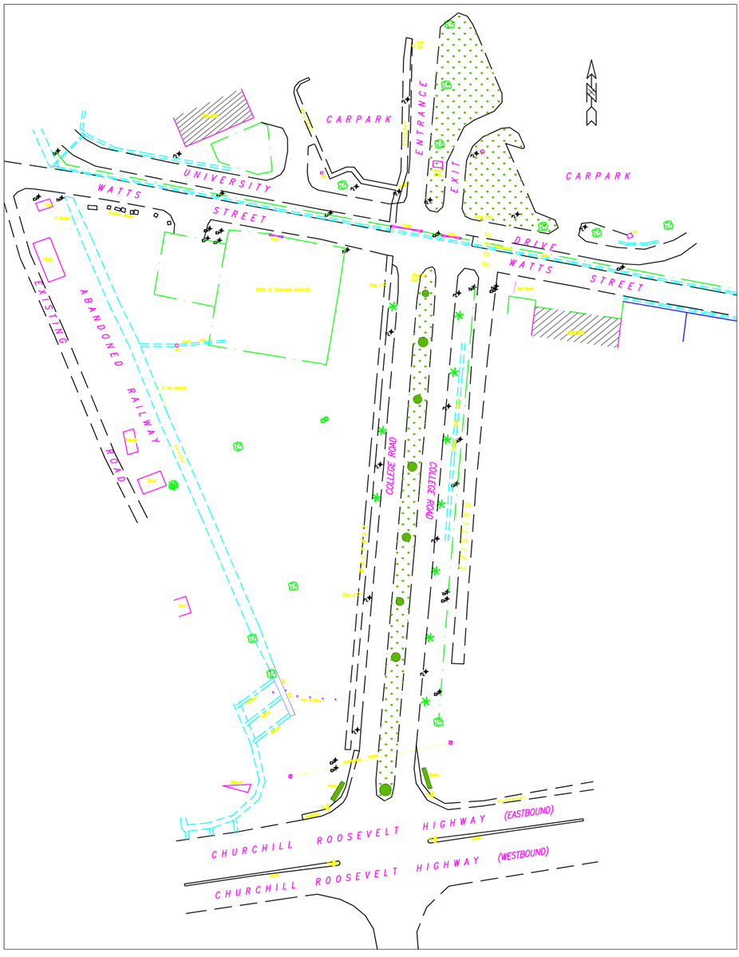
INTRODUCTION

Slide 3
INVESTIGATION CRITERIA, INCLUDING CONSTRAINTS
As a university in an urban environment, it is important that the campus emphasizes its presence and visibility as a campus precinct. Consequently, there should be intersection priority control change such that College Road should be the major road at intersection with Watts Street.
The following principles should govern transportation planning for roadway systems and traffic circulation in an urban campus environment:
Through-traffic should be directed away from the core area utilising alternative routes;
Complex intersections should be avoided; and,
Streets and land development should be designed to complement each other, that is, the local street pattern should not cut up the campus land areas into small parcels to frustrate sound development.

Slide 4
I INVESTIGATION CRITERIA, INCLUDING CONSTRAINTS
The Transportation Planning Handbook states that access to the university campuses from the city’s major arterials should be direct and should carry traffic to the intended campus entrances. It also points out that traffic not destined for the campus should be accommodated on arterial streets outside the campus boundaries
The extremely close proximity of University Drive to Watt Street,
Some of the Engineering Faculty buildings constructed very near the existing University Drive, and
The layout configuration of the current road entry and exit as well as the associated green space, all complicate any approach to readily suggest the provision of a grand campus access and frontage.
UWI South Gate is currently located only 180 metres north of the CRH at the intersection of Watts Street and College Road.

Slide 5
TRAFFIC ANALYSIS OF EXISTING SITUATION
Level of Service (LOS), in general, is a qualitative measure describing operational conditions within a traffic stream. LOS is described in terms of such factors as speed and travel time, freedom to manoeuvre, traffic interruptions, comfort and convenience, and safety.
Control delay is the portion of the total delay attributed to each lane on a given approach at an intersection
Control Delay Definition of Level of Service
For most urban areas, a LOS “D” is acceptable and LOS “C” is the standard in most in most rural areas.
LOS | Control Delay (seconds per vehicle)
A | 0–10
B | > 10–15
C | > 15–25
D | > 25–35
E | > 35–50
F | > 50

Slide 6
TRAFFIC ANALYSIS OF EXISTING SITUATION
We collected Twenty-four-hour video traffic data for the intersection from Wednesday November 6 to 8, 2019. The highest total traffic approach volumes for morning and afternoon hours were considered the AM and PM peak hours, respectively. The AM total traffic approach volumes were higher than the PM.
SIDRA INTERSECTION software is an aid for design and evaluation of individual intersections and networks of intersections. It can be used to analyse all types of intersections including, major-minor stop sign control and roundabouts. It allows modelling of separate Movement Classes (Light Vehicles, Heavy Vehicles, Buses, etc.) with different vehicle characteristics.

Slide 7
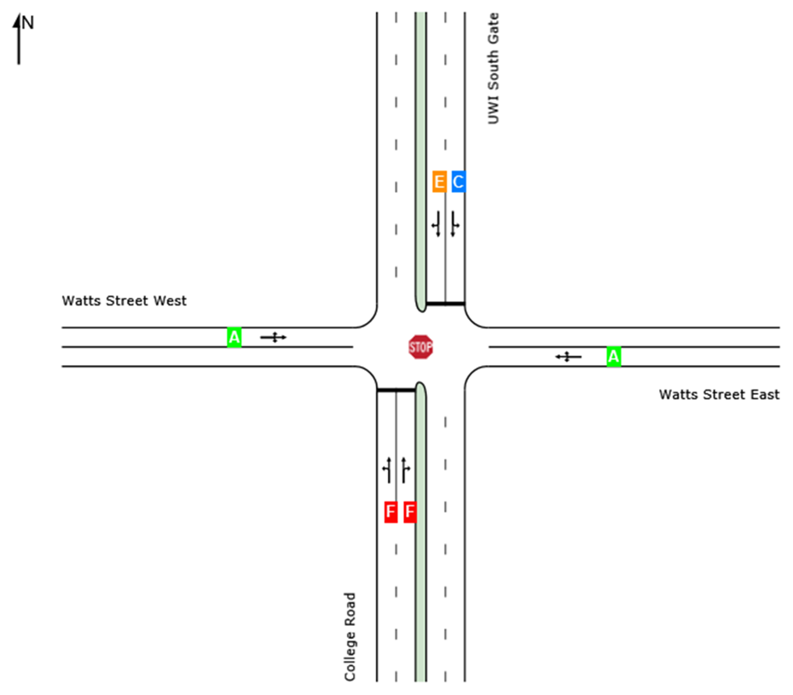
Lane Level of Service— College Rd/Watts St – Existing AM Peak Hr

Slide 8
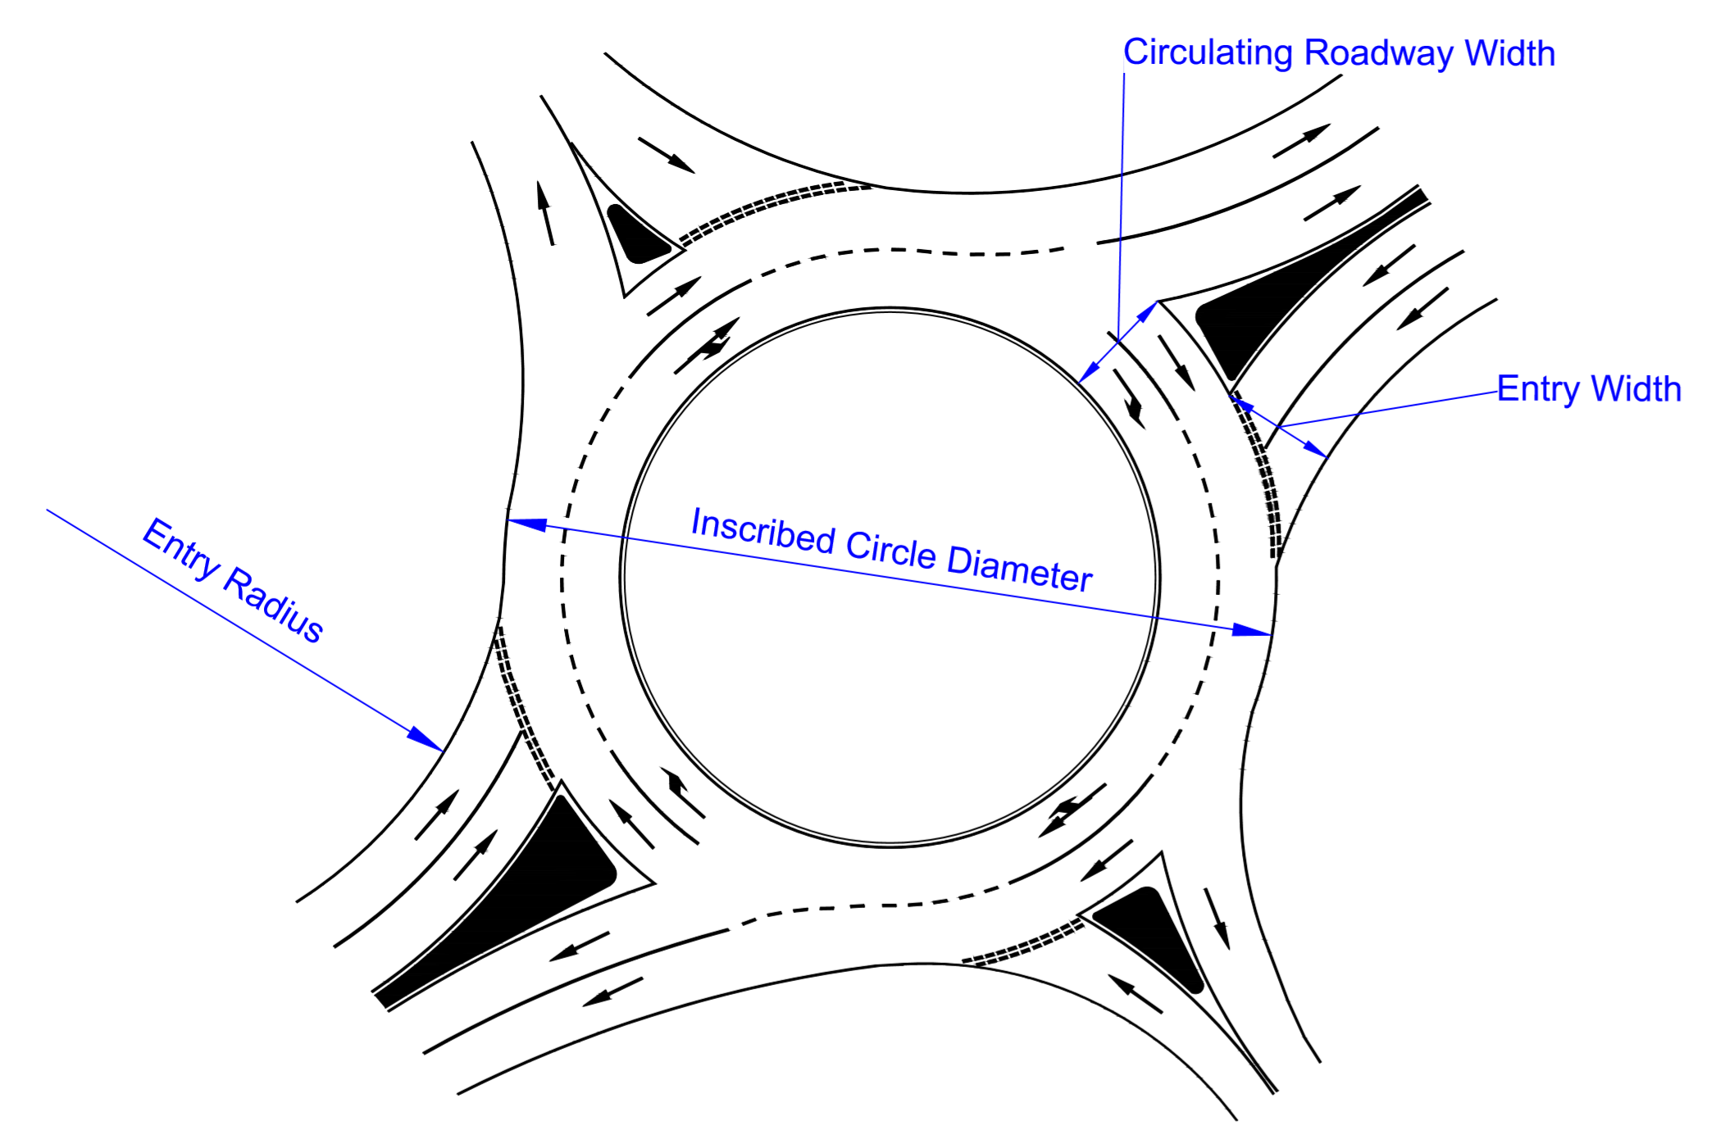
PROPOSED ROUNDABOUT BASIC PARAMETERS
Entry Radius is the minimum radius of curvature of the outside curb at the entry.
Inscribed Circle Diameter is the diameter of the largest circle that can be inscribed within the outer edges of the circulatory roadway.
Circulating Roadway Width is the width between the outer edge of the circulating roadway and the central island, not including the width of any apron, where the apron is the mountable portion of the central island adjacent to the circulatory roadway.
Entry Width is the width of the entry where it meets the inscribed circle, measured perpendicularly from the right edge of the entry to the intersection point of the left edge line and the inscribed circle.

Slide 9
P PROPOSED ROUNDABOUT BASIC PARAMETERS

Slide 10
TRAFFIC SIMULATION OF THE PROPOSED ROUNDABOUT
AIMSUN micro-simulator follows a microscopic simulation approach. This means that the behaviour of each vehicle in the network is continuously modelled throughout the simulation time period while it travels through the traffic network, according to several vehicle behaviour models (e.g., car following, lane changing).
We have assumed an annual non-site traffic growth rate of two (2) percent. Thus, in ten years, the annual vehicular growth a factor of 1.2 is to be multiplied to the directional vehicle volumes. It is assumed that the directional split would remain the same. Analysis of the projected data to year 2029 for the roundabout intersection showed that the LOS is still good during both AM and PM peak hours.
VC ratio is the ratio of the number of vehicles traversing a point or uniform segment of a lane or roadway during a specified time period (in this case, per hour) to the maximum sustainable number of vehicles which reasonably can be expected to traverse the point or uniform segment of a lane or roadway during a specified time period under prevailing roadway, geometric, traffic, environmental, and control conditions (expressed as vehicles per hour).

Slide 11
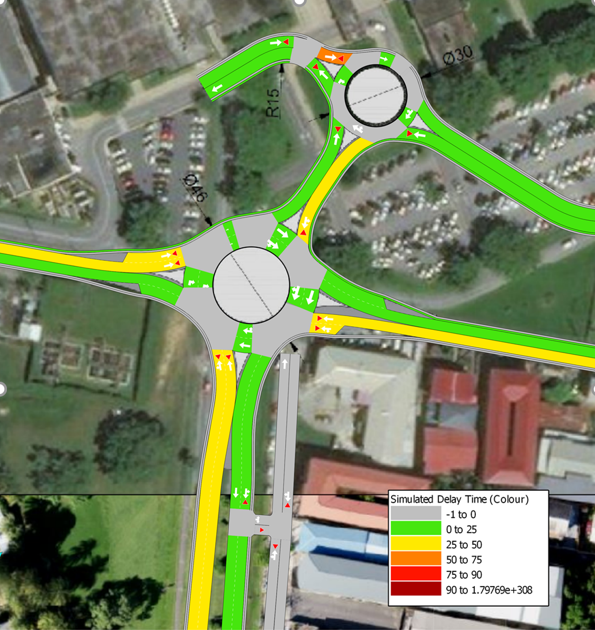
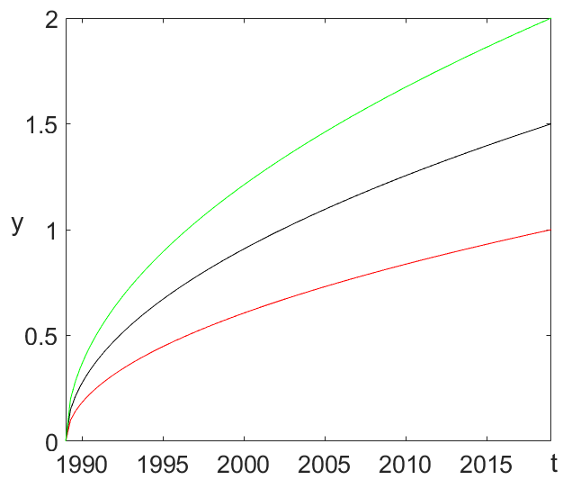
RESULTS
Figure Title

Slide 12
CONCLUSION
A double-lane roundabout has been proposed to replace the existing College Road/Watts Street major-minor stop intersection, and more importantly, to alleviate the tremendously frustrating current weekday traffic congestion during AM and PM periods for at least the next 10 years.
It includes a smaller single-lane roundabout within the campus, connecting the existing eastern and western perimeter roads in a rearranged manner, in order to (a) facilitate access to the other areas around the campus, and (b) process visitors both welcome and unwelcome to the campus.

Slide 13
THANK YOU!

