Slide 1

A REVIEW OF RECYCLED CONCRETE AGGREGATES AS A SUSTAINABLE CONSTRUCTION MATERIAL
Rekha Rampit¹*, Jovanca Smith², Indrajit Ray³,
Feyaz Mohammed⁴
^{1,2,3,4} Faculty of Engineering, The University of the West Indies, Trinidad

Slide 2
PRESENTATION OVERVIEW
Introduction
Structural Applications
Microstructure and Physical Properties
Mechanical Properties
Durability Properties
Treatment Methods
Existing Codes
Current Investigations
Conclusions

Slide 3
INTRODUCTION
After World War II in the 1940’s
Excessive amounts of CDW
Recycling CDW produced RCAs
Base course material for roads
Foundation backfill
Other non-structural purposes
[Buck, 1976]

Slide 4
INTRODUCTION
Every year 20 million tons of concrete is used globally
Increase in CO₂ emissions
Exploits natural aggregates
High energy consumption
Generation a vast amount of CDW
[Mehta, 2009]

Slide 5
STRUCTURAL APPLICATIONS OF RCAs
Rehabilitation of Haiti’s infrastructure
Reuse of waste concrete for stair cases, retaining wall and public spaces in Haiti
Over 1500𝑚³ of RAC for foundation slab an internal structural elements
Waldspirale residential building complex in Darmstadt, Germany
Over 1500𝑚³ of RAC supplied for foundations, floor slabs and columns
BRE office building
Watford, UK.
[Fardis, 2011]
[UNDP, 2013]

Slide 6
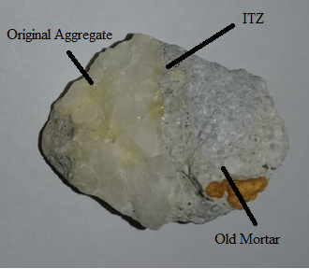
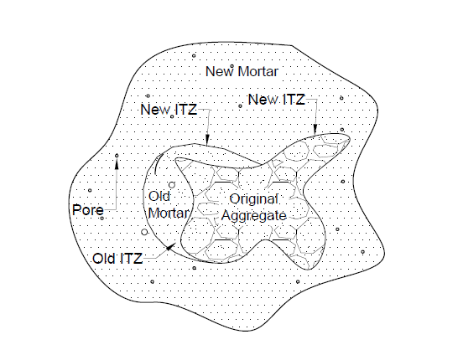
MICROSTRUCTURE OF RAC

Slide 7
MECHANICAL PROPERTIES OF RAC
Untreated RCAs
Compressive Strength
[Etxeberria, 2007]
100% of RCAs reduced 𝑓 ′𝑐 by
20-25% as compared to NAs
A w/c ratio of 0.5 was used
Tensile Strength
[Seara-Paz, 2016]
100% of RCAs reduced tensile strength between 23-31%
A 15% replacement of NAs with RCA resulted in a 9% decrease in strength
RCA - waste recycling center
RCAs - 4/10, 10/16, 16/25 mm
Wetted via sprinkler system
150-mm-cubes used (21 °C)
RCA - concrete demolition debris
RCAs - 4–16 mm
Pre-soaked for 10-min
Cubic specimens used

Slide 8
DURABILITY PROPERTIES OF RAC
Durability is the ability to withstand significant deterioration over a long period of time. This is an important factor of concrete especially when resistance to weathering, chemical attack and abrasion is of priority in reinforced concrete structures [Stanish, 2001].
Compressive Strength versus Corrosion time [Wang, 2013]
Samples | Compressive Strength (MPa)
 | NAC | RAC – 30% | RAC – 60%
4 months | 28.92 | 27.34 | 25.79
8 months | 28.39 | 26.66 | 24.99
12 months | 26.86 | 25.70 | 23.43
16 months | 25.80 | 23.49 | 22.11

Slide 9
TREATMENT METHODS FOR RCAs
Acid Treatment
Crushed RCA granite from 20 year old demolished structure (25 MPa)
10% N HCL
(1.5% mortar loss)
18% increase in $f^{′}c$ at 28days
10% N HCL
(1.5% mortar loss)
18% increase in 𝑓^′ 𝑐 at 28days
Crushed RCA from concrete cube specimens from lab
0.5M HCL
(3% mortar loss)
10% increase in $f^{′}c$ at 28days
0.5M HCL
(3% mortar loss)
10% increase in 𝑓^′ 𝑐 at 28days
10% N H2SO4
(5.6% mortar loss)
20% increase in $f^{′}c$ at 28days
10% N H2SO4
(5.6% mortar loss)
20% increase in 𝑓^′ 𝑐 at 28days
[Saravanakumar, 2016]
[Ismail, 2014]

Slide 10
EXISTING CODES FOR RCAs
Brazil
“Recycled aggregates from construction and demolition waste (2005)”
Allows both coarse and fine RCAs for non-structural concrete; pavements
Germany
“Aggregates for concrete and mortar”
The use of 25% of RCAs is permitted for C30/37 grade structural concrete
United Kingdom
“Concrete-Complementary British Standard (2002)”
The use of 20% of RCAs is permitted for C20/25 grade structural concrete
Hong Kong
“Specification facilitating the use of recycled aggregates (2002)”
The use of 20% of RCAs is permitted for 35 MPa grade structural concrete
[De Brito and Saikia, 2012]

Slide 11
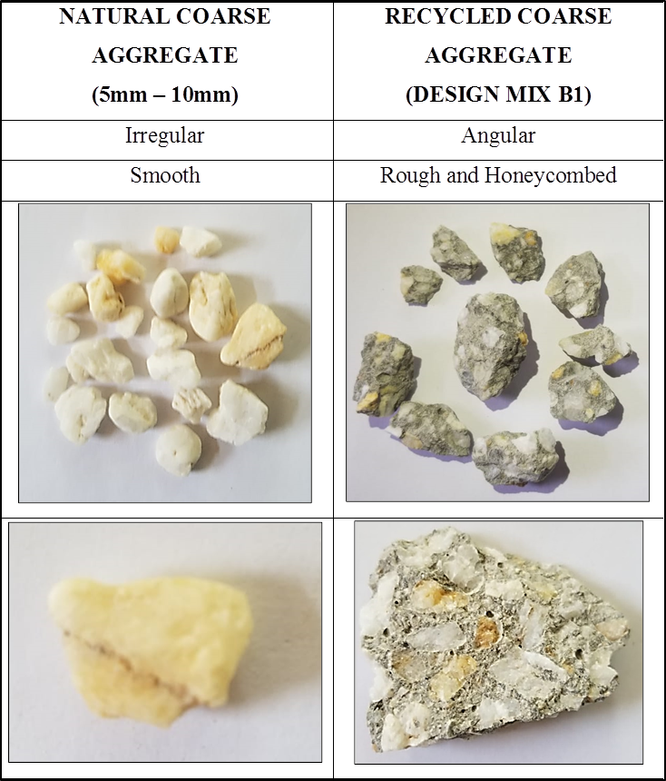
CURRENT INVESTIGATIONS FOR RCAs
Effects of Varying Mortar Depths of Recycled Concrete Aggregates

Slide 12
CURRENT INVESTIGATIONS FOR RCAs
“Wood” you like to Recycle Concrete?
RCA + Wood
New building material
Bending strength superior to original concrete
May reduce construction cost and CO2
[Science Daily, 2020]

Slide 13
CONCLUSIONS
The mechanical and durability performance of RAC are generally inferior to conventional concrete.
Through pre-treatment methods such as the use of acid and fine mineral fillers has shown to enhance the density, water absorption and strengthen the ITZs.
The use of treated RCAs is viewed as sustainable construction material which can be used as a replacement to that of NAs.
Fracture Energy
Chloride Penetration

Slide 14
REFERENCES
Buck, A.D., Recycled concrete as a source of aggregate. 1976, ARMY ENGINEER WATERWAYS EXPERIMENT STATION VICKSBURG MISS.
Mehta, P.K. and H. Meryman, Tools for reducing carbon emissions due to cement consumption. Structure, 2009. 1(1): p. 11-15.
Anik, D., C. Boonstra, and J. Mak, Handbook of sustainable building. James & James. 1996.
Fardis, M. N. (2011). Innovative materials and techniques in concrete construction: ACES Workshop, Springer Science & Business Media.
Etxeberria, M., et al., Influence of amount of recycled coarse aggregates and production process on properties of recycled aggregate concrete. Cement and concrete research, 2007. 37(5): p. 735-742.
Seara-Paz, S., et al., Influence of recycled coarse aggregates characteristics on mechanical properties of structural concrete. European Journal of Environmental and Civil Engineering, 2016. 20(sup1): p. s123-s139.

Slide 15
REFERENCES
McNeil, K. and T.H.-K. Kang, Recycled concrete aggregates: A review. International Journal of Concrete Structures and Materials, 2013. 7(1): p. 61-69.
Stanish, K., R.D. Hooton, and M.D. Thomas, Testing the Chloride Penetration Resistance of Concrete: A Literature Review. 2001, United States. Federal Highway Administration.
Wang, J., et al., Mechanical Properties of Recycled Concrete in Marine Environment. Vol. 2013. 2013. 728357.
Ismail, S. and M. Ramli, Mechanical strength and drying shrinkage properties of concrete containing treated coarse recycled concrete aggregates. Construction and Building Materials, 2014. 68: p. 726-739.
Saravanakumar, P., K. Abhiram, and B. Manoj, Properties of treated recycled aggregates and its influence on concrete strength characteristics. Construction and Building Materials, 2016. 111: p. 611-617.
De Brito, J. and N. Saikia (2012). Recycled aggregate in concrete: use of industrial, construction and demolition waste, Springer Science & Business Media.
Institute of Industrial Science, The University of Tokyo. "'Wood' you like to recycle concrete?."ScienceDaily.https://www.sciencedaily.com/releases/2020/02/200220101119.

Slide 16
THANK YOU!

