Slide 1
EXPLORING AN OPTIMIZATION STRATEGY AT THE MAINTENANCE DEPARTMENT OF AN OIL COMPANY Stefan Harrison¹, Jainarine Bansee², Boppana Chowdary³, Rajeev Seepersad⁴, Dillon Frederick⁵
^{1,2,3}University of The West Indies
⁴$Burmac CNG$
⁵Angostura Ltd.

Slide 2
INTRODUCTION
This paper introduces a lean approach to the operation of an oil company within the Caribbean region.
The subject of the study is the company’s pump maintenance and repair job shop, referred to as the Pump Shop.
Within the company, the repair process of failed pumps and other related maintenance activities is performed internally at the Pump Shop.

Slide 3
OBJECTIVES
The issue faced by the oil company:
Maintaining capital discipline with a focus placed on productivity improvements.
Devising an approach to maintenance practices that improves efficiency and productivity.
The solution investigated:
Adopting a lean approach to maintenance.
The reduction of overtime related to maintenance activities .
The case study investigated maintenance activities at the firm through simulation modelling of proposed lean measures.

Slide 4
METHODOLOGY
Subject experts were consulted during the process of model formulation which was comprised of:
Value stream mapping and identification of performance metrics.
Data collection and observation of the system.
Defining a model of the system in its existing state.
Determining the desired precision of performance metrics.
Constructing a simulation model of the existing system.
Verifying & Validating the simulation model.
Conceptualize Proposed Solutions.
Generate a simulation model of proposed system.
The simulation output of the proposed and existing models was then subject to further statistical analysis.

Slide 5
PROCESS MAP
Diagnosis & Disassembly Pump Shop
Repair, Assembly & Testing
Pump Shop
Incoming Pumps & Work Order
Outgoing Pumps & Work Order
Parts/Materials Request
Parts/Materials & Delivery Note
Part/Material Retrieval
Stores Department
Parts/Materials
Purchase Request
Procured Parts/Materials
Shipping and Receiving
Purchase Order Procurement Department
Supplier
Delivery Details

Slide 6
MODEL FORMULATION
Processes & Statistical Distributions
Process | Distributions
Inter-Arrival time (hours) | 8 + WEIB(50.3, 0.623)
Number of arriving pumps | 0.5 + WEIB(0.804, 1.92)
Transport to storage address (minutes) | 15 + 17 * BETA(1.99, 1.5)
Disassembly and Diagnosis of equipment (hours) | NORM(2.98, 0.093)
Assembling repaired equipment (hours) | 1.48 + 3.52 * BETA(3.43, 5.08)

Slide 7
MODEL FORMULATION
The following assumptions and limitations were applied to the existing and proposed models created:
All materials entering the Machine Shop for any particular pump were treated as one job.
Parts were categorized as either good, or bad.
Variations in the type of parts and materials were not considered.
The distance travelled by the parts removed from the disassembly area was not considered.
The variations in the type and model of pumps entering the system was not considered.
Suppliers were assumed to provide reliable service of an acceptable standard to the company.

Slide 8
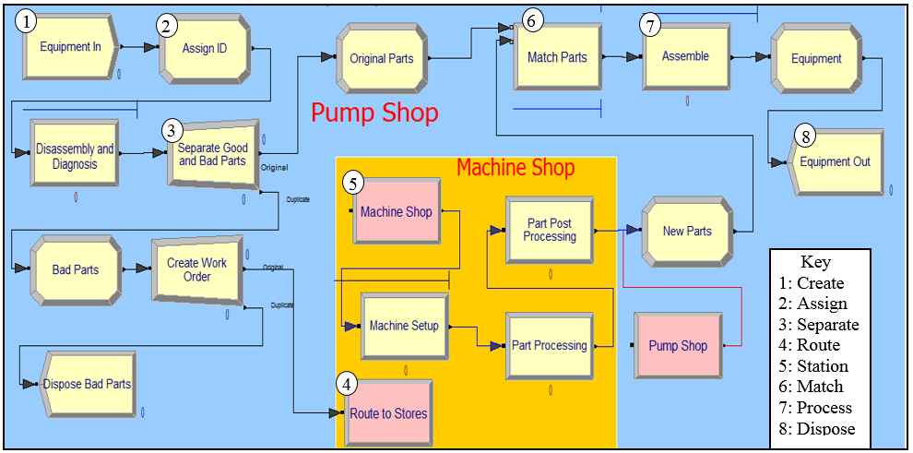
MODEL FORMULATION
1
2
6
7
3
8
5
Key
1: Create
2: Assign
3: Separate
4: Route
5: Station
6: Match
7: Process
8: Dispose
4
Extract from Existing Model, Pump Shop. Pump repair processes.

Slide 9
MODEL FORMULATION
Extract from Existing Model, Pump Shop. Pump repair processes.

Slide 10
MODEL FORMULATION
Proposed Measures:
The automation of data storage and retrieval:
Further integrating maintenance procedures into the firm’s Enterprise Resource Planning (ERP) system.
The use of tools and devices such as barcodes and radio frequency identification (RFID) tags to automate data entry.
Predictive maintenance:
Determining when servicing operations are required by monitoring the condition of machines and analysing the relationship between multiple parameters and part degradation.
On-board intelligent alarm systems & networked condition monitoring devices e.g. Vibration sensors, Magnetic sensors.
The analysis of historical data by trained personnel.

Slide 11
MODEL FORMULATION
The use of an automated data storage and retrieval system was modelled as a reduction in the time spent on data entry and information retrieval tasks.
The effect of a predictive maintenance practice was reproduced in the model by having arriving entities first enter the model at Stores department in the form of a parts request.
This represented a process where the analysis of historical and condition monitoring data allowed the maintenance department to predict the likely occurrence of machine failure modes.
Parts and materials required for repairs were secured prior to the initiation of maintenance activities.

Slide 12
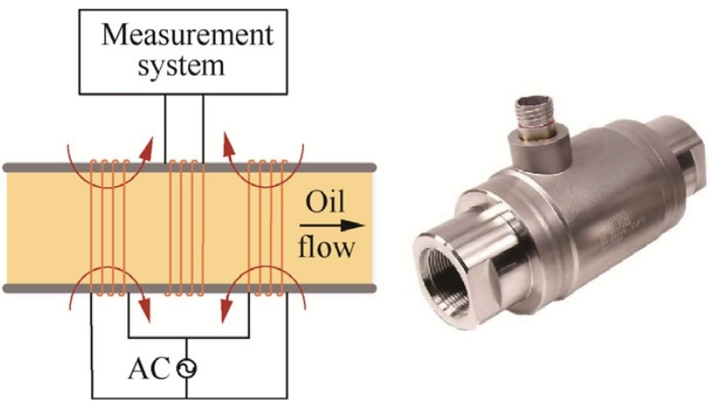
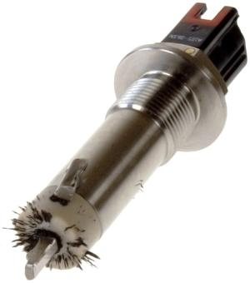
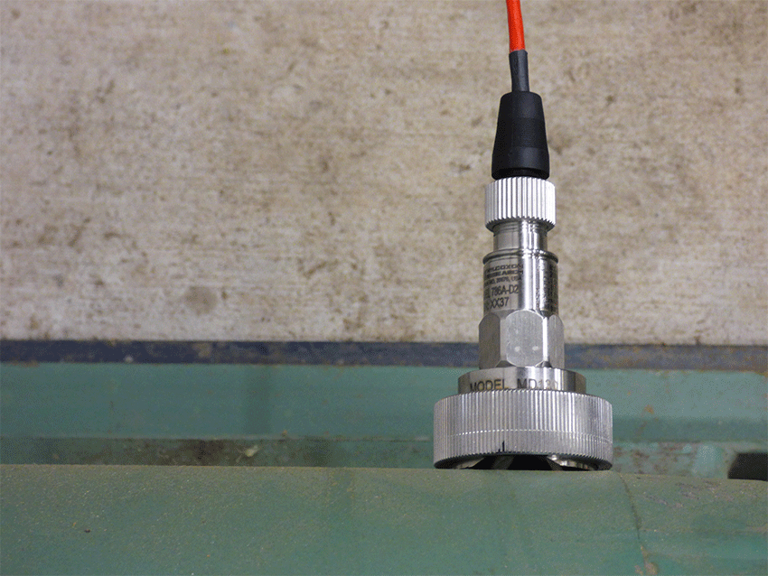
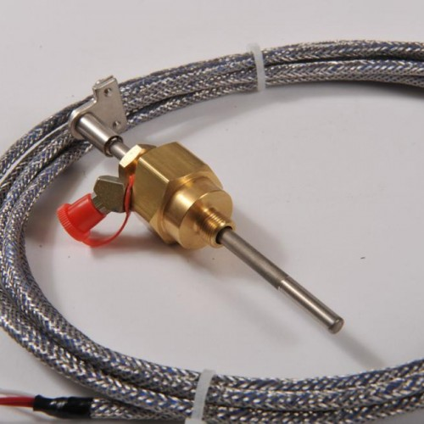
MODEL FORMULATION
Examples of Condition Monitoring Sensors
Magnetic Sensor
Source: Mechanical Wear Debris Feature, Detection, and Diagnosis: A Review. ODU Digital Commons. 2018
Bearing Temperature Sensor
Source: Muller Beltex
©2020 — Concept & realisatie door Brandindustry
Magnetic Sensor
Source: Machinery Lubriation © 2020 Noria Corporation
Vibration Sensor
Source: Wilcoxon Sensing Technologies®
© 2020 Amphenol (Maryland), Inc.

Slide 13
MODEL FORMULATION
Extract from Proposed Model, Stores Department
Extract from Proposed Model, Pump Shop

Slide 14
RESULTS
Performance Metrics of the Existing and Proposed Models
Performance Metrics | Existing Model | Proposed Model | Precision
Waiting Time | 28 | 1 | ± 1 hour
Flow Time | 38 | 9 | ± 1 hour
WIP | 1 | 1 | ± 1 pump
Average WT decreased by 96%
Average FT decreased by 76%

Slide 15
RESULTS
Independent Samples t-Tests
Performance Metrics | t | d.f. | Sig (2-tailed)
WT | 10.77 | 29.66 | < 0.001
FT | 8.51 | 30.03 | <0.001
WIP | 1.24 | 55.75 | 0.221
The decrease in WT and FT between the Proposed and Existing Models was determined to be a significant difference at the 95% C.I.
No significant difference was determined for WIP.

Slide 16
REFERENCES
International Energy Agency. 2019. The Impact of the Financial and Economic Crisis on Global Energy Investment. International Energy Agency.
J. V. Mitchell and B. Mitchell. Structural crisis in the oil and gas industry. In Energy Policy 64, (2014) 36-42.
T. van de Graaf and B. Michael. Stranded wealth: rethinking the politics of oil in an age of abundance. International Affairs 94, no. 6, (2018) 1309-1328.
W.D. Kelton, R. P. Sadowski and N. B. Zupick. Simulation with Arena. 6th ed. New York: McGraw Hill, 2015.
M. Gopalakrishnan, A. Skoogh and C. Laroque (2013). ‘Simulation-Based Planning of Maintenance Activities in the Automotive Industry’. In Proceedings of the 2013 Winter Simulation Conference. J.W. Marriott Hotel, Washington, D. C. USA. (pp. 2610-2621). IEEE.

Slide 17
REFERENCES
A. En-Nhaili, A. Meddaoui and D. Bouami. Effectiveness improvement approach basing on OEE and lean maintenance tools. International Journal of Process Management and Benchmarking 6, no. 2 (2016) 147-169.
J. Santos, R. Wysk and J.M. Torres, 2006. Improving Production with Lean Thinking. John Wiley & Sons, Inc.
J. Gavigan and S. Larson. 2016. Utilizing PI Data to Enhance Maintenance and Reliability Program. 2016 SMRP Annual Conference. Society for Maintenance and Reliability Professionals. SMRP.
E. Gilabert, and A. Arnaiz. Intelligent automation systems for predictive maintenance: A case study. Robotics and Computer-Integrated Manufacturing 22 no. 5, (2006) 543-549.

Slide 18
REFERENCES
I. Shohet, and L. Nobili. Enterprise resource planning system for performance-based-maintenance of clinics. Automation in Construction 65 (2016) 33-41.
B. Eckfeldt. What does RFID Do for the Consumer? Communication of the ACM 48, no. 9, (2005) 77-79.
G. Borriello. RFID: Tagging the World. Guest Editorial to RFID Special Issue. Communications of the ACM. 48, no. 9, (2005) 34-37.
J. Chongwatpol and R. Sharda. Achieving Lean Objectives through RFID: A Simulation‐Based Assessment. Decision Sciences 44, no.2, (2013) 239-266.
P. Cassingham, and D. Allen (2008). ‘Mining the Corporate Data Domain Safely and Securely Across the Enterprise’. Electric Energy T&D Magazine, March 2008 Issue. Terrebonne, Quebec Canada.

Slide 19
THANK YOU!

