Slide 1
NUMERICAL STUDY OF MHD CONVECTIVE NANOFLUID FLOWS WITHIN A CORRUGATED TRAPEZOIDAL ENCLOSURE Victor M. Job¹, Sreedhara Rao Gunakala², P.V.S.N. Murthy³, R. Panneer Selvam⁴
^{1,2}Department of Mathematics and Statistics,
The University of the West Indies, Trinidad
³Department of Mathematics, Indian Institute of Technology Kharagpur, India
⁴Department of Civil Engineering, University of Arkansas, U.S.A.

Slide 2
INTRODUCTION
Free convection flows within trapezoidal enclosures
Design and operation of heat exchangers or solar collectors
fluid flows and heat transfer in microchannels
cooling of micro-electromechanical (MEMS) systems
heat transfer performance limited by the low thermal conductivities of conventional fluids: water, oil, EG.
Nanofluids identified as innovative method of heat transfer enhancement.

Slide 3
MOTIVATION AND OBJECTIVES
Heat transfer enhancement achieved in trapezoidal geometries compared to rectangular geometries (Mamun et al. 2010, Job and Gunakala 2016, etc.).
Effects of sidewall inclination angle and Eckert number on convective nanofluid flows have not been considered.
Aim: To investigate the influence of sidewall inclination angle and Eckert number on unsteady flow and heat transfer phenomena in alumina-water and SWCNT-water nanofluids.

Slide 4
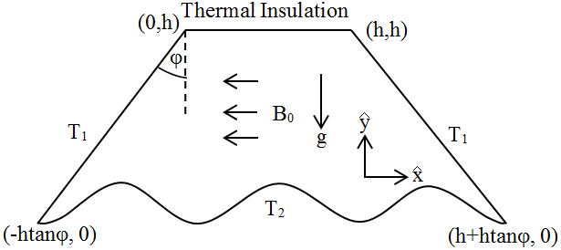
PROBLEM DESCRIPTION
Figure: Schematic Diagram of the Problem

Slide 5
ASSUMPTIONS
Magnetic Reynolds number is very small.
Electric force induced by the applied magnetic field is negligible.
Thermal radiation is neglected.
Temperature difference in fluid is sufficiently small - Boussinesq approximation is applicable.

Slide 6
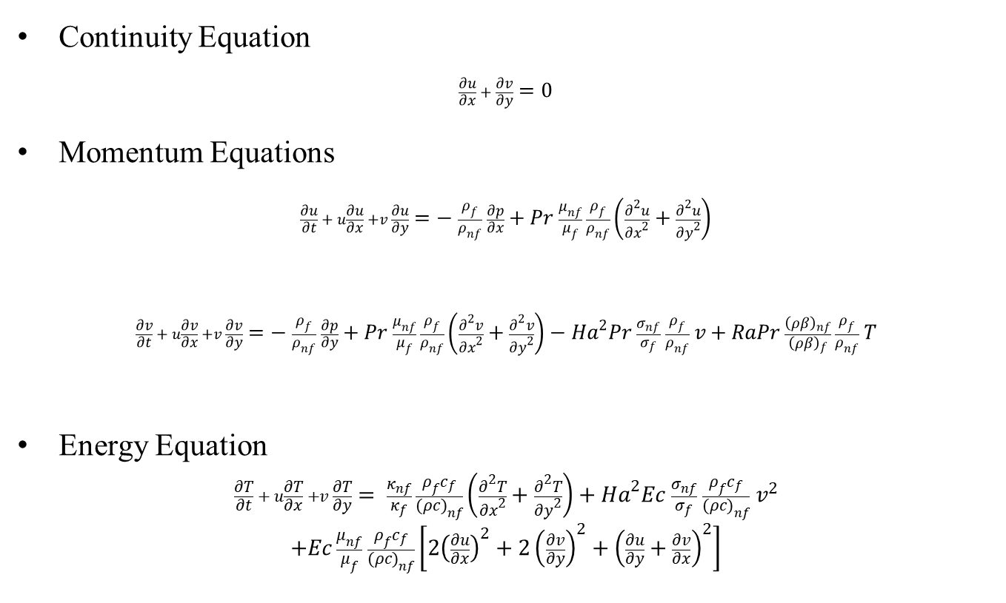
GOVERNING EQUATIONS
Continuity Equation
$$\frac{∂u}{∂x} + \frac{∂v}{∂y}=0$$
Momentum Equations
$$\frac{∂u}{∂t} + u\frac{∂u}{∂x} +v \frac{∂u}{∂y}=− \frac{ρ_{f}}{ρ_{nf}} \frac{∂p}{∂x}+Pr \frac{μ_{nf}}{μ_{f}} \frac{ρ_{f}}{ρ_{nf}}\left(\frac{∂^{2}u}{{∂x}^{2}}+\frac{∂^{2}u}{{∂y}^{2}}\right)$$
$$\frac{∂v}{∂t} + u\frac{∂v}{∂x} +v \frac{∂v}{∂y}=− \frac{ρ_{f}}{ρ_{nf}} \frac{∂p}{∂y}+Pr \frac{μ_{nf}}{μ_{f}} \frac{ρ_{f}}{ρ_{nf}}\left(\frac{∂^{2}v}{{∂x}^{2}}+\frac{∂^{2}v}{{∂y}^{2}}\right)−{Ha}^{2}Pr \frac{σ_{nf}}{σ_{f}} \frac{ρ_{f}}{ρ_{nf}} v+RaPr \frac{{\left(ρβ\right)}_{nf}}{{\left(ρβ\right)}_{f}} \frac{ρ_{f}}{ρ_{nf}} T$$
Energy Equation
$$\frac{∂T}{∂t} + u\frac{∂T}{∂x} +v \frac{∂T}{∂y}= \frac{κ_{nf}}{κ_{f}} \frac{ρ_{f}c_{f}}{({ρc)}_{nf}}\left(\frac{∂^{2}T}{{∂x}^{2}}+\frac{∂^{2}T}{{∂y}^{2}}\right)+{Ha}^{2}Ec \frac{σ_{nf}}{σ_{f}} \frac{ρ_{f}c_{f}}{({ρc)}_{nf}} v^{2}$$
$$+Ec \frac{μ_{nf}}{μ_{f}} \frac{ρ_{f}c_{f}}{({ρc)}_{nf}}\left[2{\left(\frac{∂u}{∂x}\right)}^{2}+2{\left(\frac{∂v}{∂y}\right)}^{2}+{\left(\frac{∂u}{∂y}+\frac{∂v}{∂x}\right)}^{2}\right]$$

Slide 7
Initial/Boundary Conditions
Initial Conditions:
$$u=v=T=0 at t=0$$
Boundary Conditions:
$$u=v=0, T=1 on the bottom wall$$
$$u=v=T=0 on the left and right walls$$
$$u=v=0, \frac{∂T}{∂y}=0 on the top wall$$

Slide 8
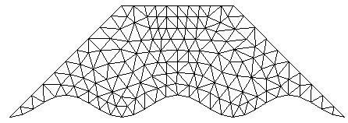
METHODOLOGY
Mixed Finite Element Method
Piecewise linear interpolation on triangular elements
Polynomial Pressure Projection Stabilization
Mesh with 8148 elements used to ensure sufficient accuracy of solution
Method implemented in MATLAB

Slide 9
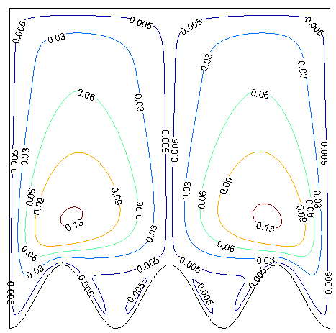
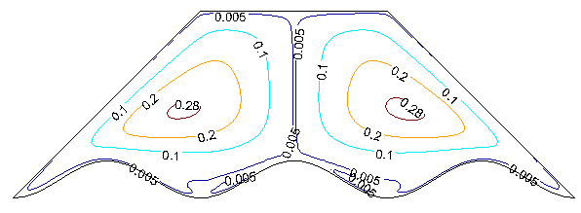
RESULTS
Figure: Streamline Plots ($Al_{2}O_{3}$-Water Nanofluid)
$$φ=0^{∘}$$
$$φ={45}^{∘}$$

Slide 10
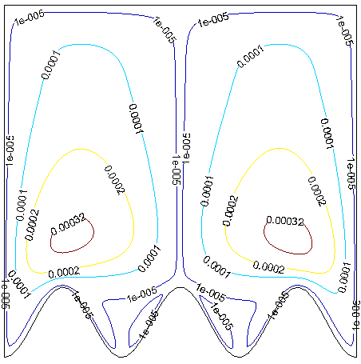
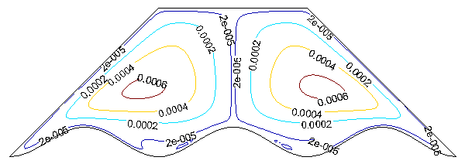
RESULTS
Figure: Streamline Plots (SWCNT-Water Nanofluid)
$$φ=0^{∘}$$
$$φ={45}^{∘}$$

Slide 11
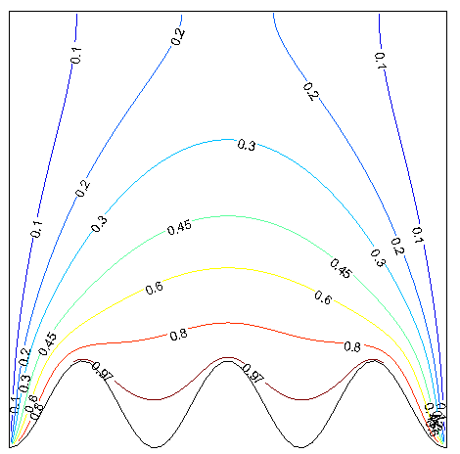
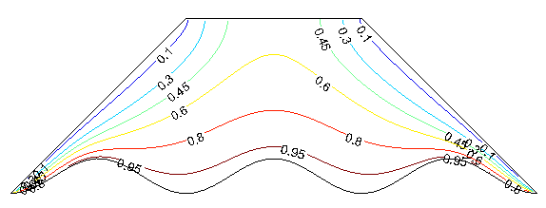

RESULTS
Figure: Isotherm Plots ($Al_{2}O_{3}$-Water Nanofluid)
$$φ=0^{∘}$$
$$φ={45}^{∘}$$

Slide 12
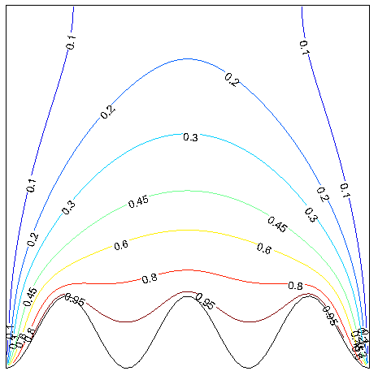
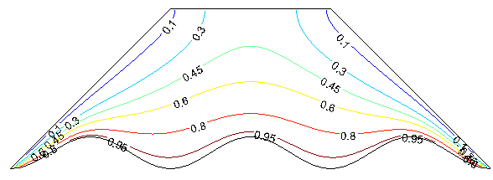
RESULTS
Figure: Isotherm Plots (SWCNT-Water Nanofluid)
$$φ=0^{∘}$$
$$φ={45}^{∘}$$

Slide 13
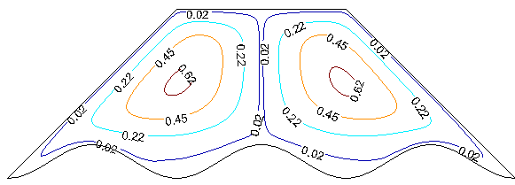
RESULTS
Figure: Streamline Plots ($Al_{2}O_{3}$-Water Nanofluid)
$$Ec={10}^{−5}$$
$$Ec={10}^{−4}$$

Slide 14
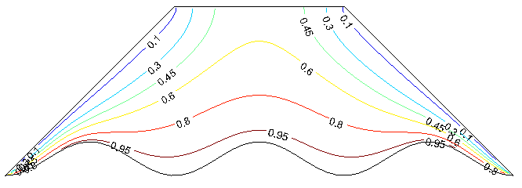
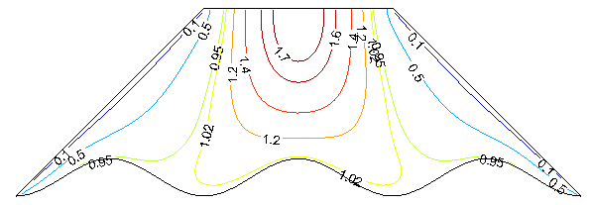
RESULTS
Figure: Isotherm Plots ($Al_{2}O_{3}$-Water Nanofluid)
$$Ec={10}^{−5}$$
$$Ec={10}^{−4}$$

Slide 15
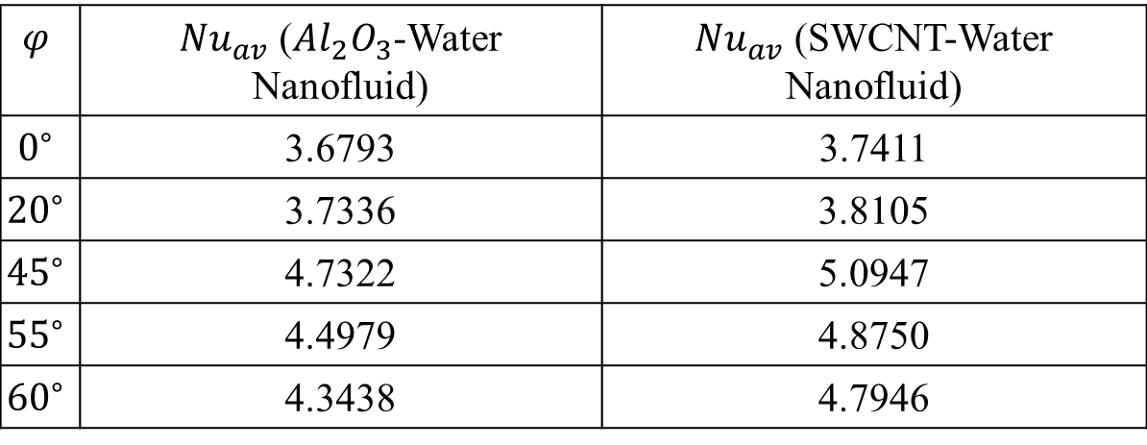
RESULTS
Heat transfer rate - Average Nusselt number on the corrugated bottom wall Γ:
$${Nu}_{av}=\frac{1}{l(Γ)}\int_{Γ}{ \frac{∂T}{∂n}}dl$$
Table: Average Nusselt Number for Different $φ$
$$φ$$ | $Nu_{av}$ ($Al_{2}O_{3}$-Water Nanofluid) | $Nu_{av}$ (SWCNT-Water Nanofluid)
$$0^{∘}$$ | 3.6793 | 3.7411
$${20}^{∘}$$ | 3.7336 | 3.8105
$${45}^{∘}$$ | 4.7322 | 5.0947
$${55}^{∘}$$ | 4.4979 | 4.8750
$${60}^{∘}$$ | 4.3438 | 4.7946

Slide 16
RESULTS
Table: Average Nusselt Number for Different $Ec$
$$Ec$$ | $Nu_{av}$ ($Al_{2}O_{3}$-Water Nanofluid) | $Nu_{av}$ (SWCNT-Water Nanofluid)
$${10}^{−6}$$ | 4.7524 | 5.0947
$${10}^{−5}$$ | 4.7322 | 5.0947
$${10}^{−4}$$ | 4.0716 | 5.0947

Slide 17
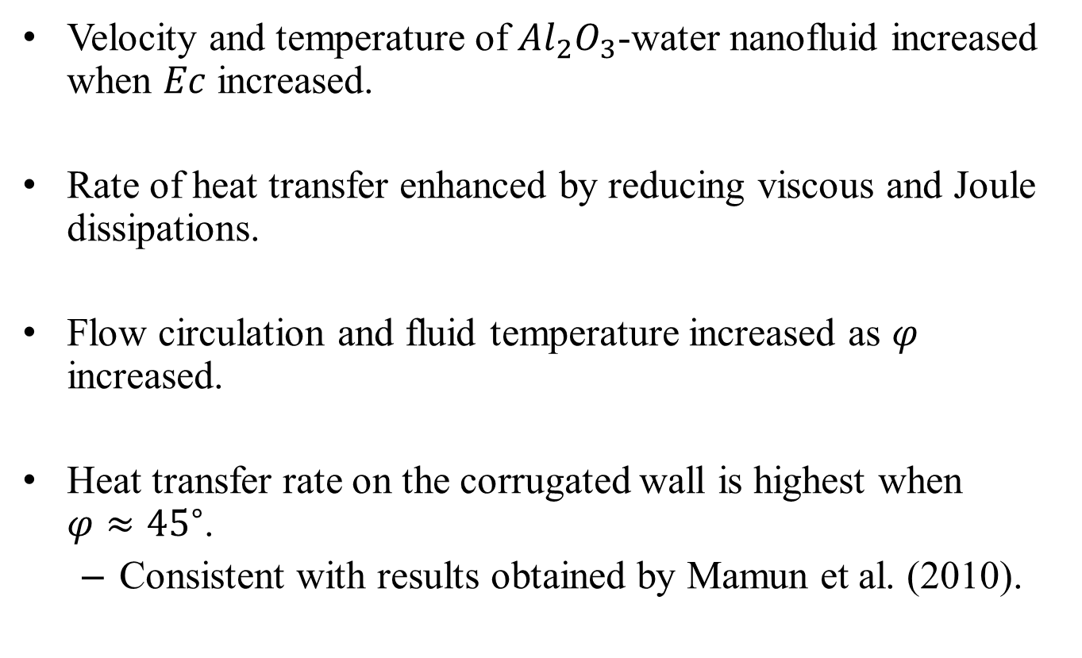
CONCLUSIONS
Velocity and temperature of $Al_{2}O_{3}$-water nanofluid increased when $Ec$ increased.
Rate of heat transfer enhanced by reducing viscous and Joule dissipations.
Flow circulation and fluid temperature increased as $φ$ increased.
Heat transfer rate on the corrugated wall is highest when $φ≈{45}^{∘}$.
Consistent with results obtained by Mamun et al. (2010).

Slide 18
REFERENCES
Job, V. M. , and S. R. Gunakala. 2016. “Unsteady MHD free convection nanofluid flows within a wavy trapezoidal enclosure with viscous and Joule dissipation effects.” Numerical Heat Transfer, Part A: Applications 69(4): 421-443.
Job, V. M., Gunakala S. R., B. Rushi Kumar, and R. Sivaraj. 2017. “Time-dependent hydromagnetic free convection nanofluid flows within a wavy trapezoidal enclosure.” Applied Thermal Engineering 11: 363-377.
Mamun, M. A. H., Islam, M. T., and M. M. Rahman. 2010. “Natural convection in a porous trapezoidal enclosure with magneto-hydrodynamic effect.” Nonlinear Analysis: Modelling and Control 15(2): 159-184.

Slide 19
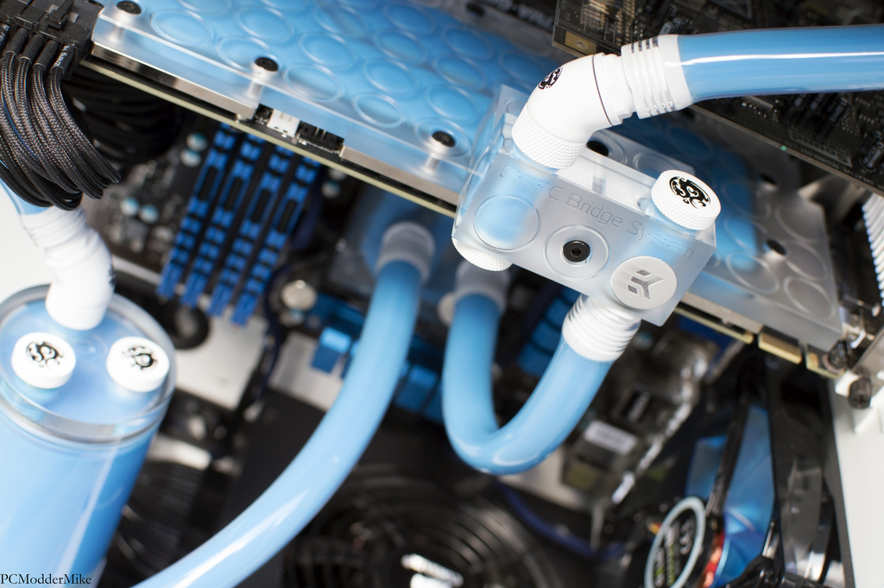
THANK YOU!

